Slide 1
Bank Loan Case Study
By:
KUNDA NAVEEN KUMAR DAS

Slide 2
Project Description
This project aims to give you an idea of applying EDA in a real business scenario.
In this project, apart from applying the techniques in the EDA module, you will also develop a basic understanding of risk analytics in banking and financial services.
Understand how data is used to minimize the risk of losing money while lending to customers.

Slide 3
Approach
Download the dataset.
There is huge data present in dataset.
Start with data cleaning process.
Give insights accordingly.

Slide 4
Tech-Stack Used
I used jupyter notebook because the dataset provided is huge.

Slide 5
Insights
Overall approach of analysis:
We have two datasets namely
previous_application.csv-contains the data of clients who applied for loan in past.
application_data.csv - contains the data of clients who applied for loan now.
I start with data cleaning.I will find the number of nulls present in the dataset.
I removed the columns which has the null percentage greater than 35%.

Slide 6
I filled the remaining nulls using mean and median if the column is numerical else mode if the column is categorical.
I completed the EDA on both datasets simultaneously.
In this report,I summarised the results and provided business insights.

Slide 7
Missing Data
There are 122 columns and 30751 rows are present in Application_data.csv dataset.
There are has 37 columns and 1670214 rows are present in previous_application.csv dataset.
I removed the columns which has more than 35% null percentage.
I removed the columns that are not necessary.

Slide 8
I filled the remaining nulls as
1)if the column is numerical
I filled the null values with median if there are any outliers.
I filled the null values with mean if there is no outliers.
2)if the column is categorical
I filled the nulls with mode value of that column.

Slide 9
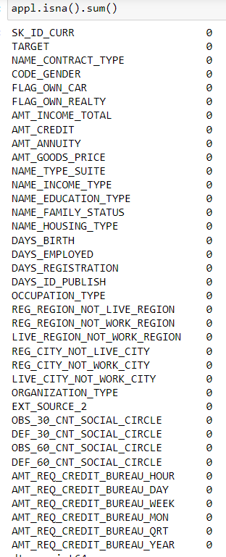
After data cleaning process the datasets look like:
Application_data.csv:

Slide 10
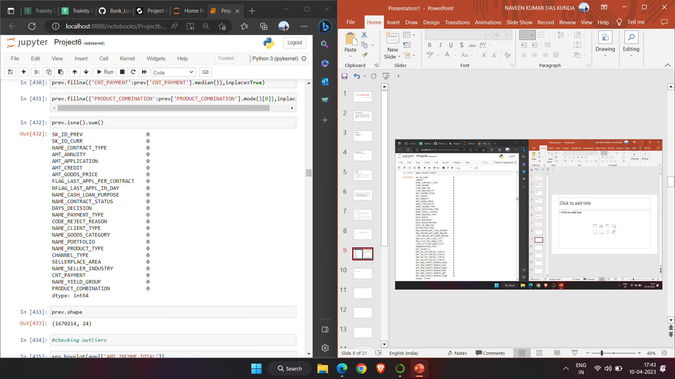
Previous_application.csv:

Slide 11
Outliers:
Application_data.csv
The ouliers are the extreme high or extreme low datapoints relative to the nearest datapoint.
In the graph of AMT_ANNUITY there is outlier which is the point after 250000 in the graph.
Like this for every column outliers are found.

Slide 12
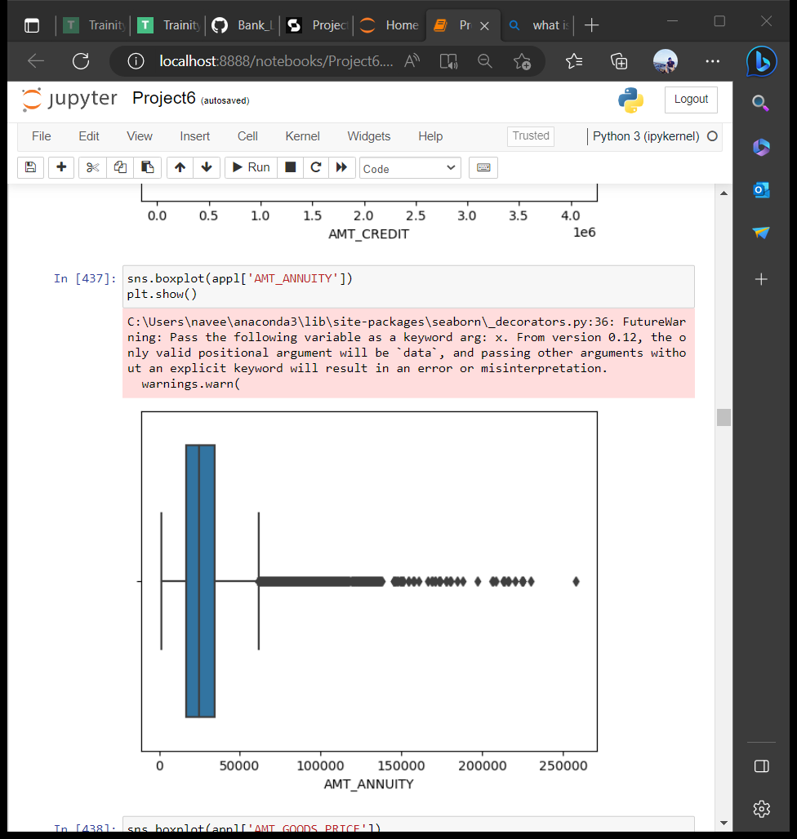
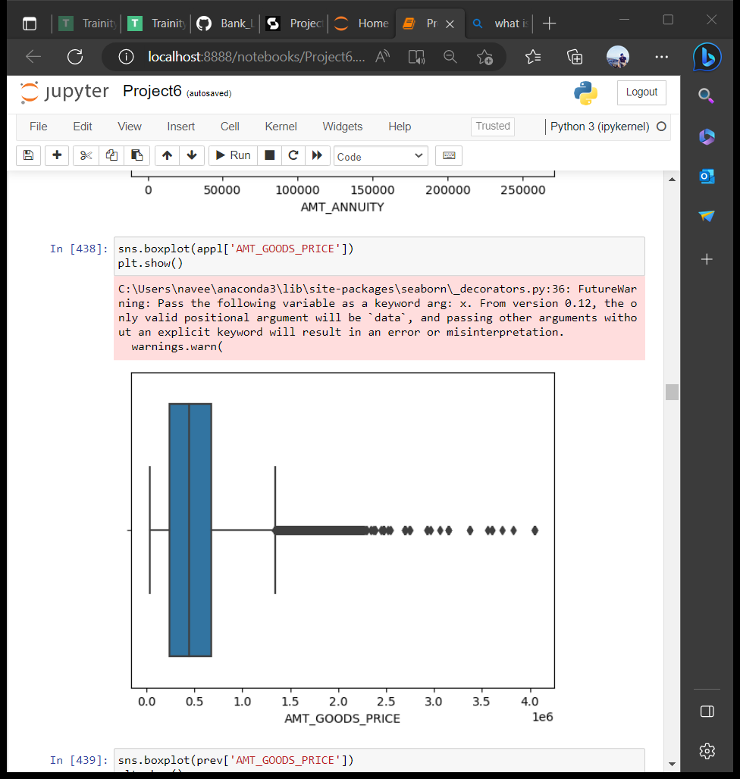

Slide 13
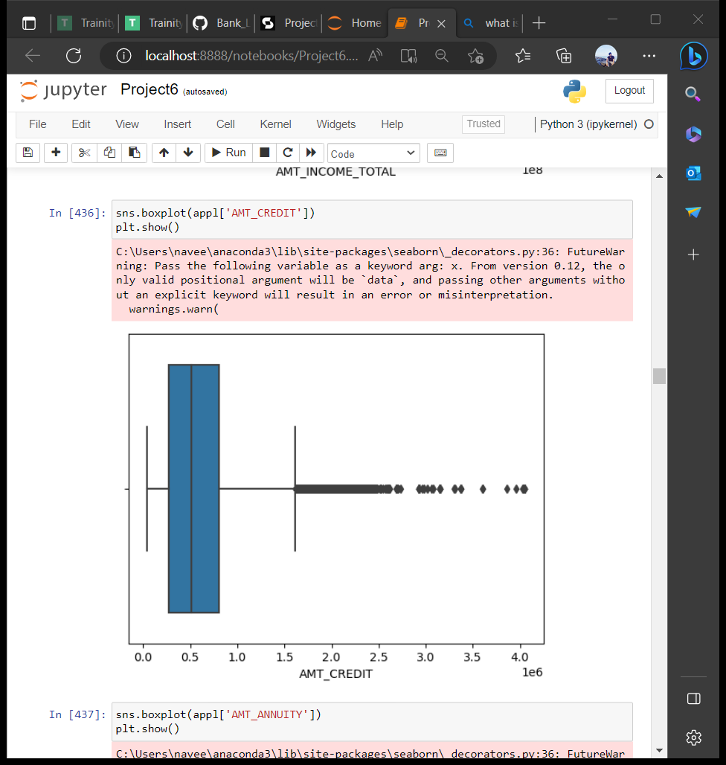
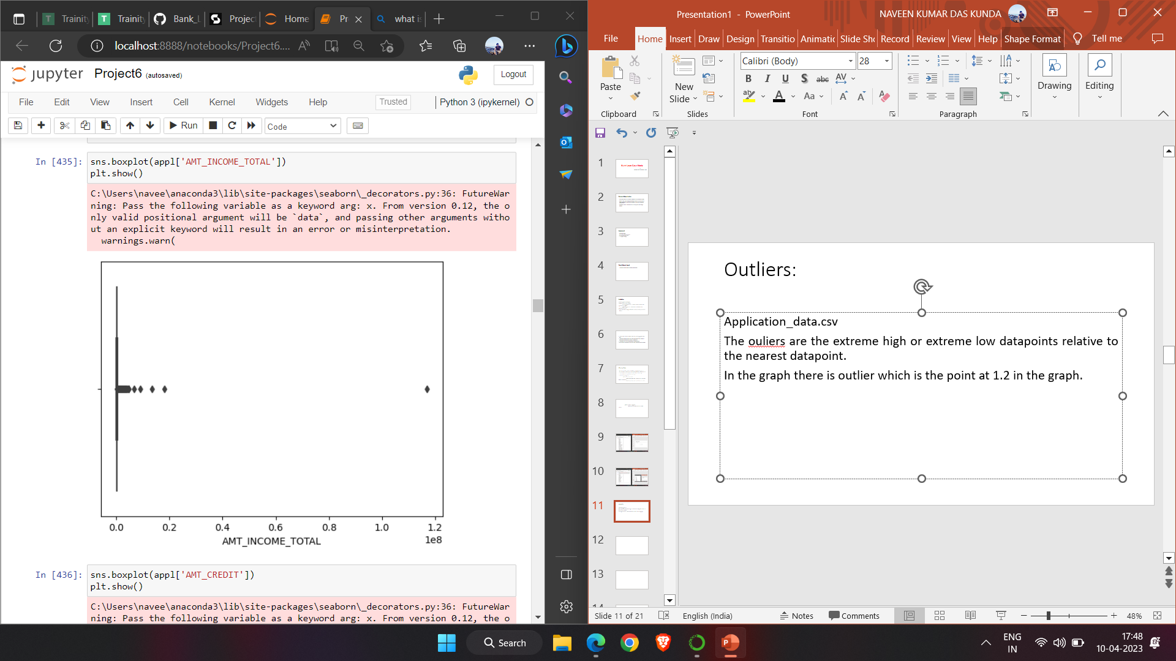

Slide 14
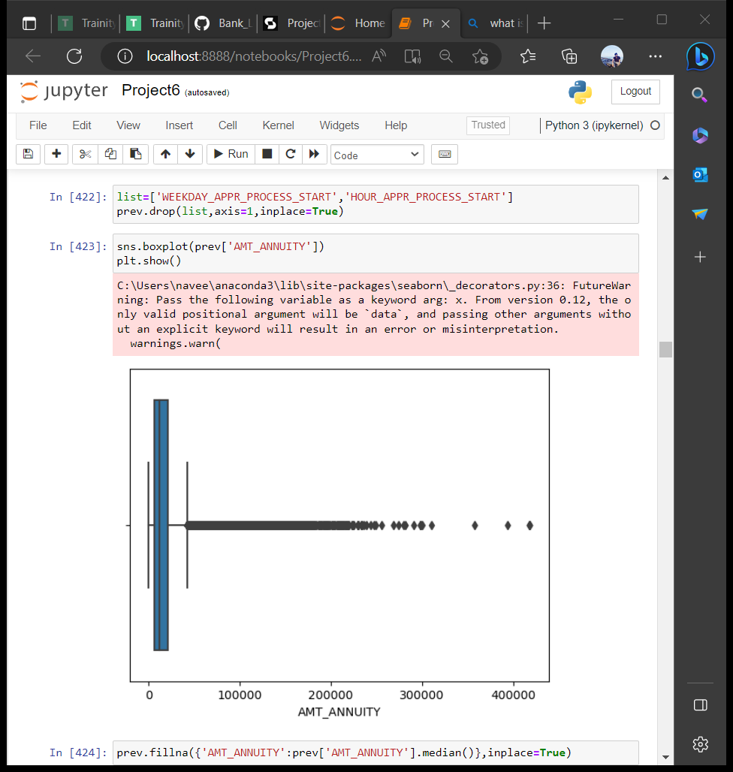
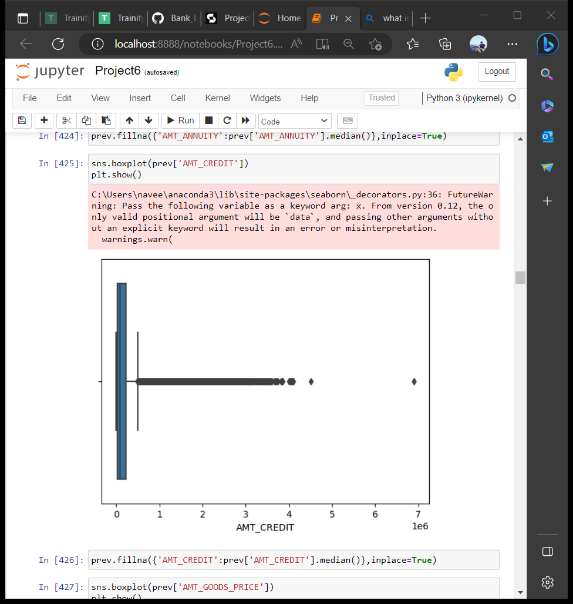
Previous_application.csv

Slide 15
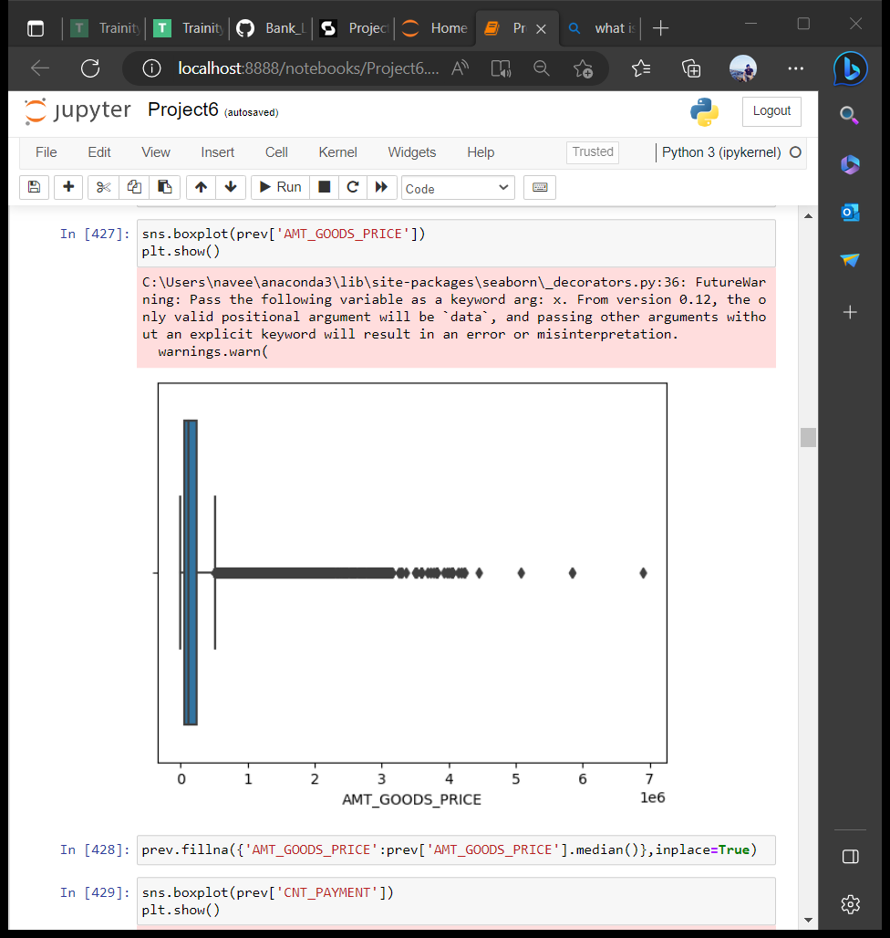
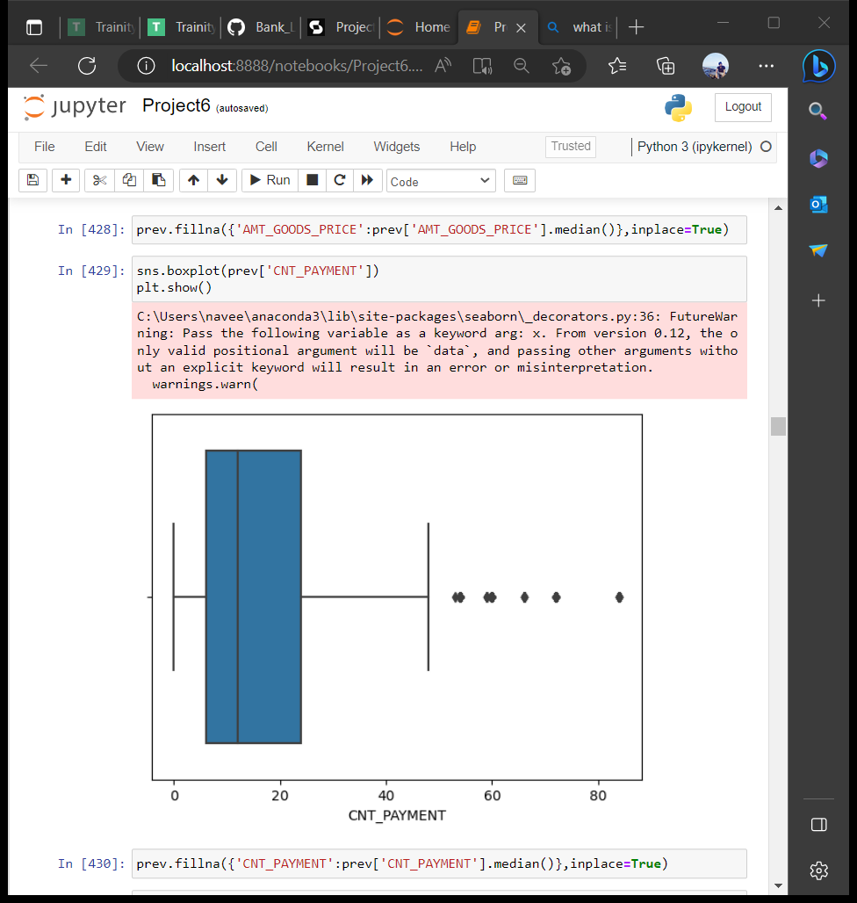

Slide 16
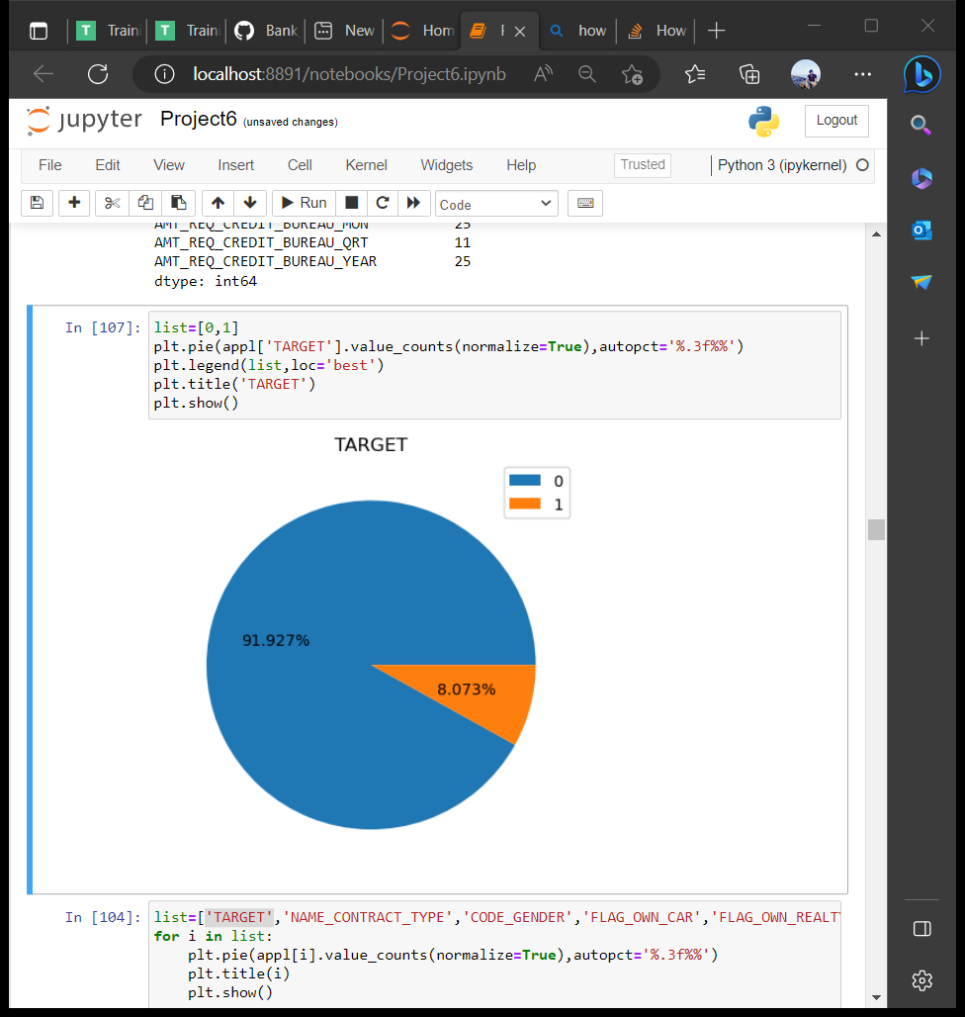
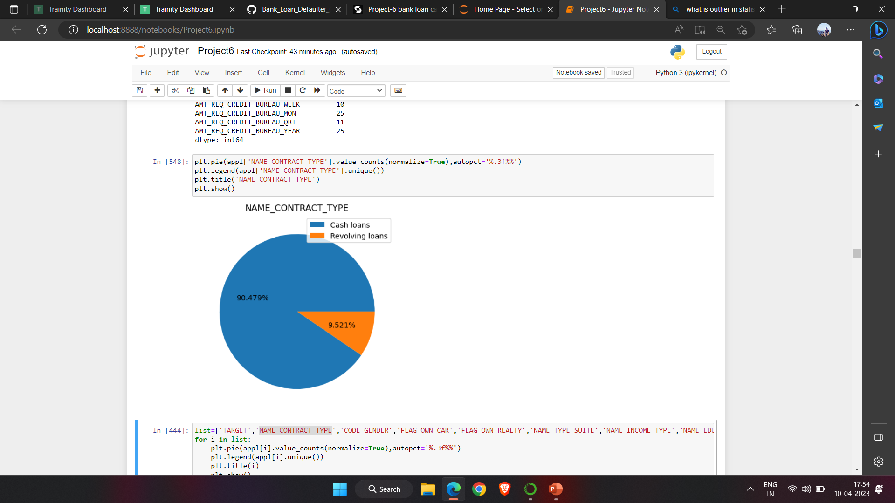
Checking imbalance
Application_data.csv
I find the data imbalance using pie chart and bar chart.

Slide 17
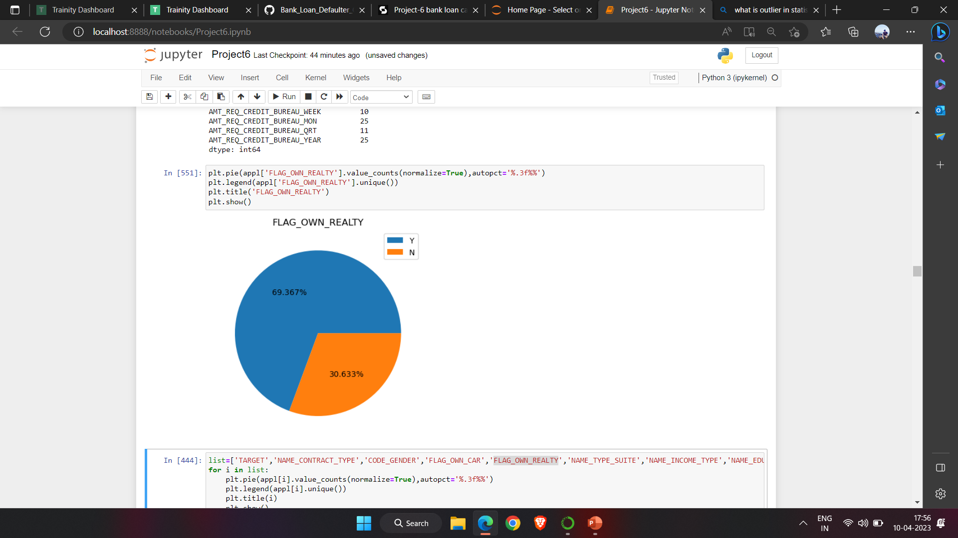
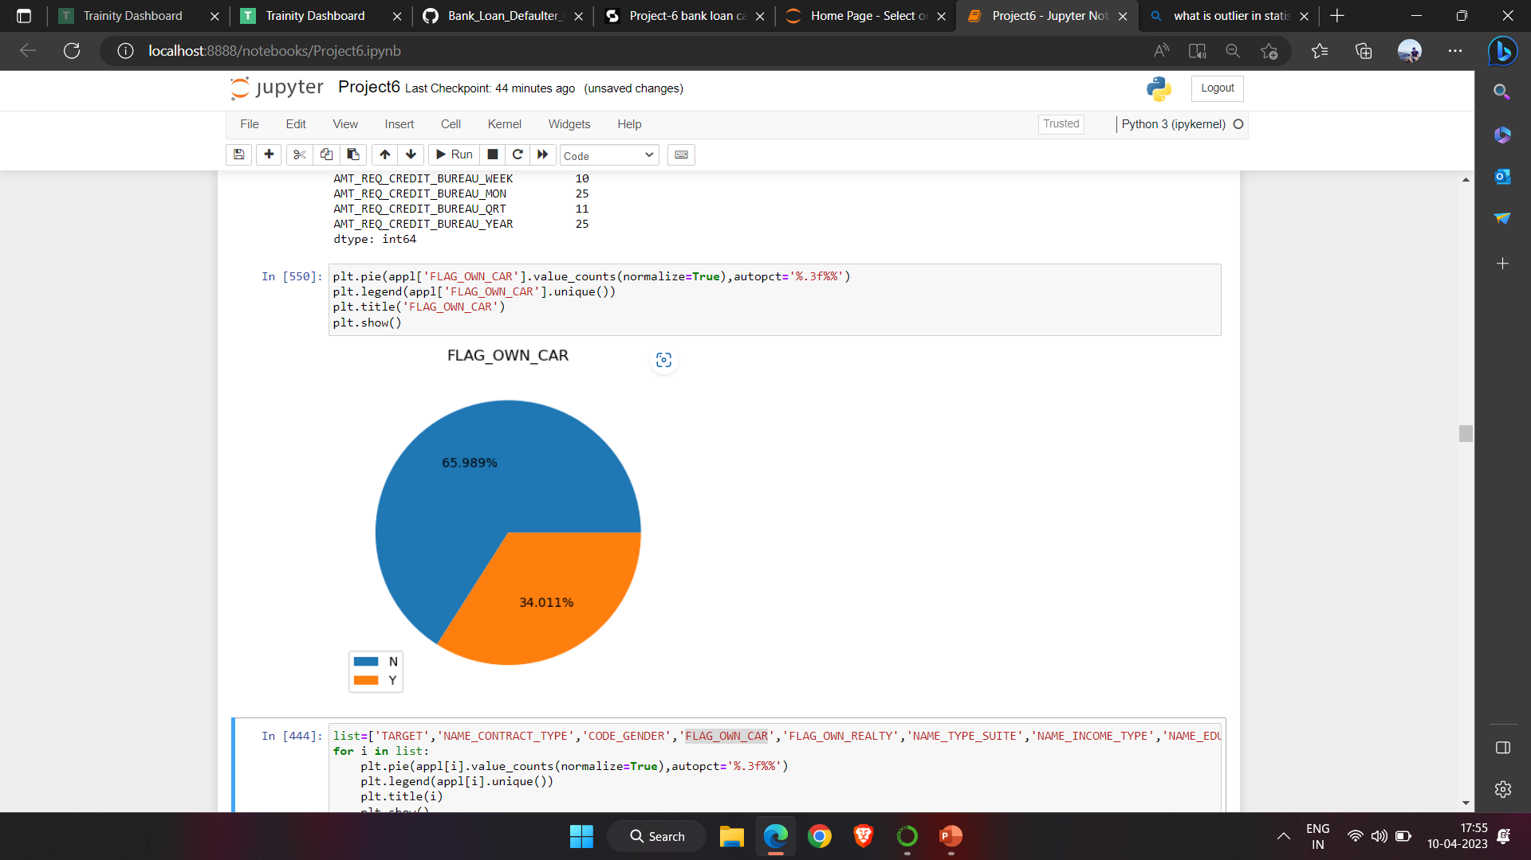

Slide 18
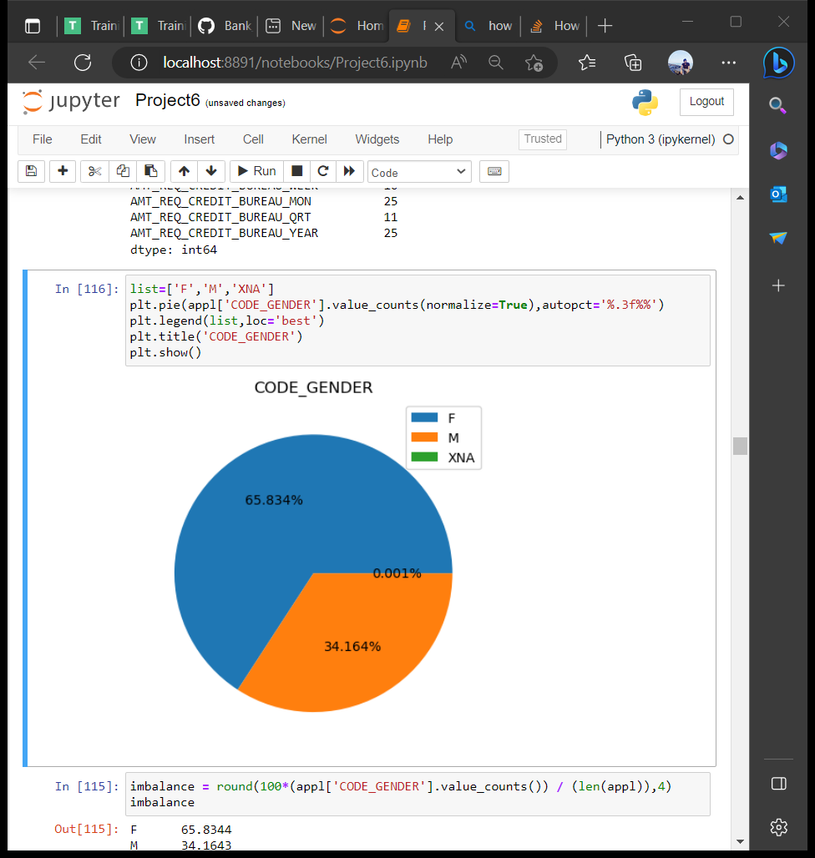

Slide 19
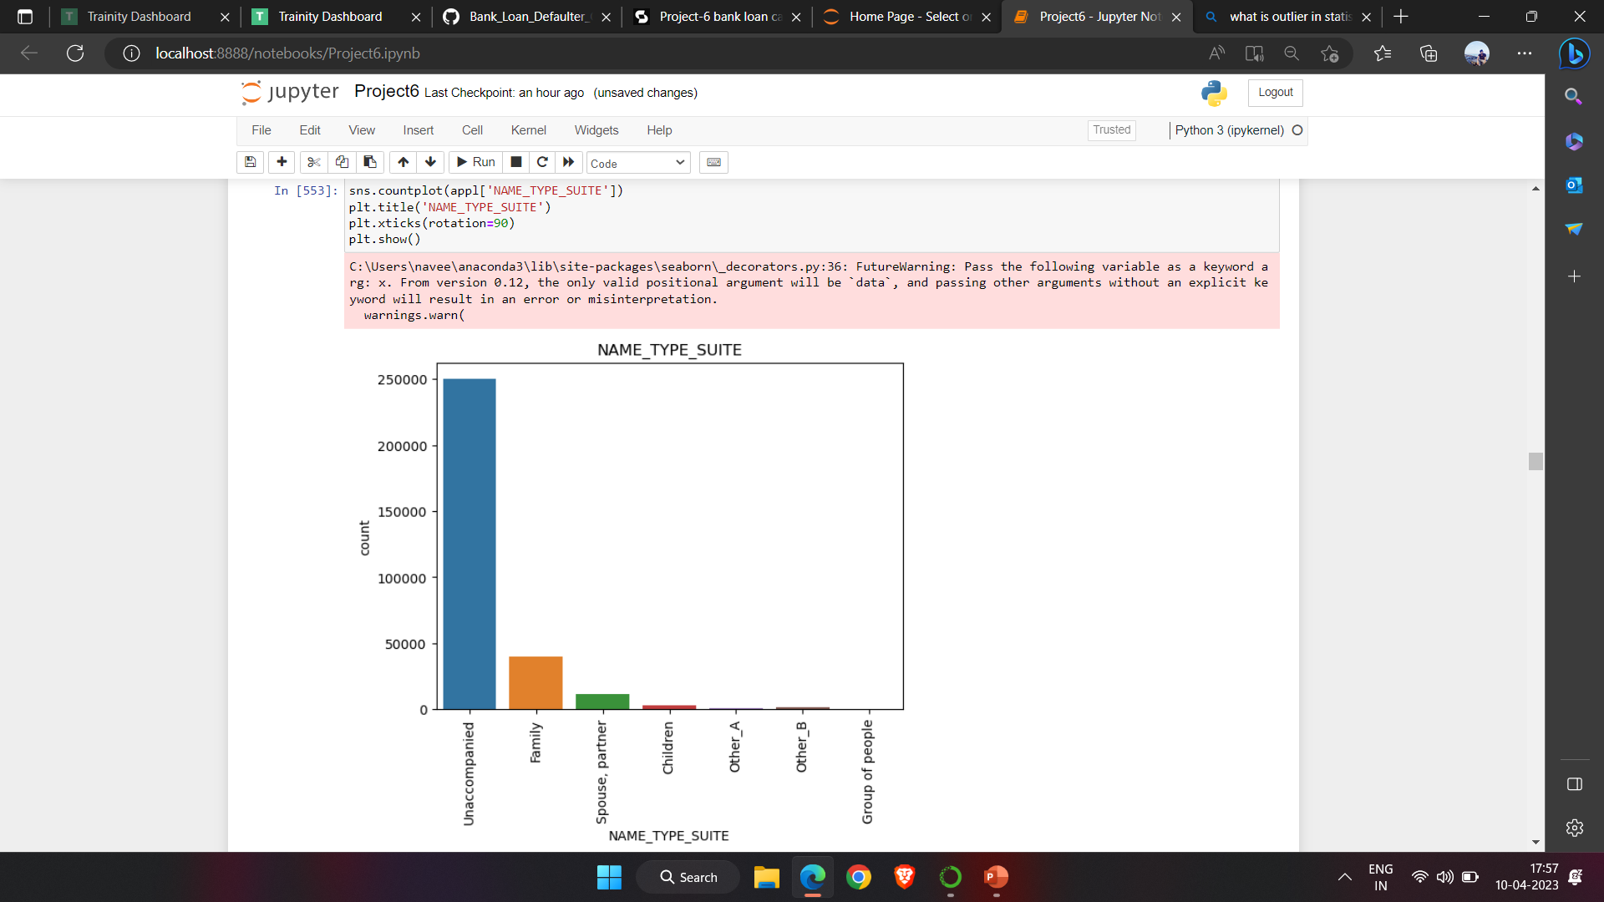
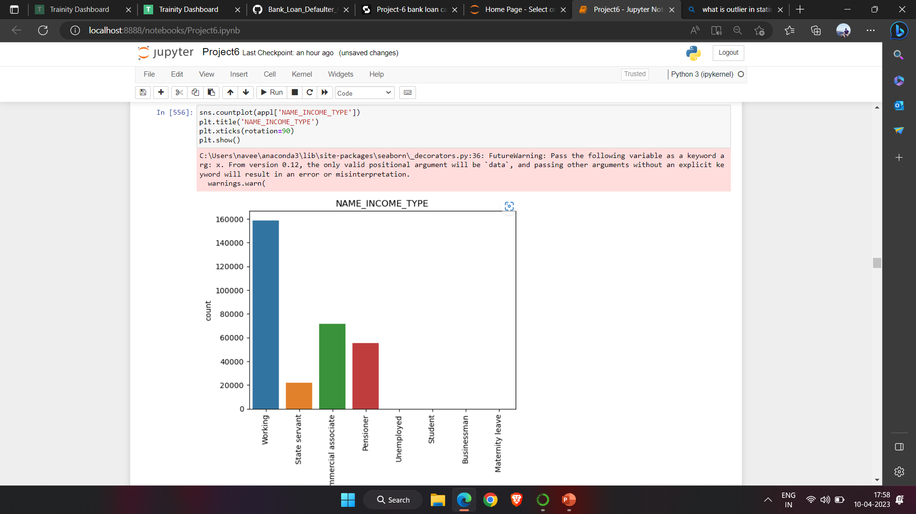

Slide 20
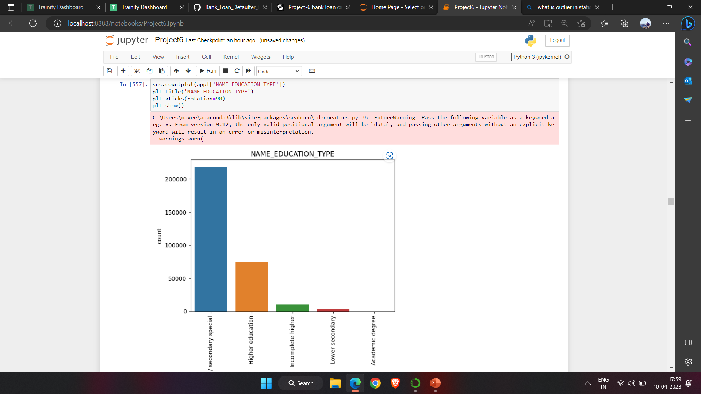
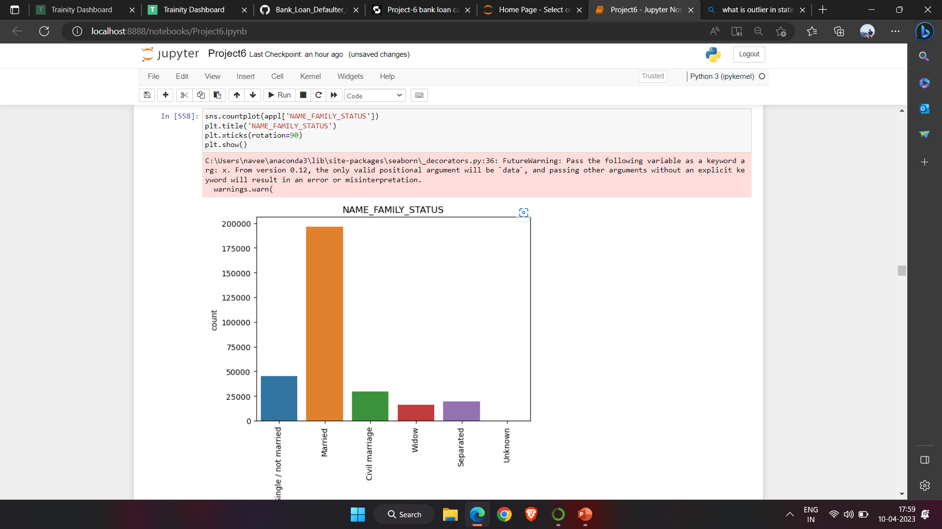

Slide 21
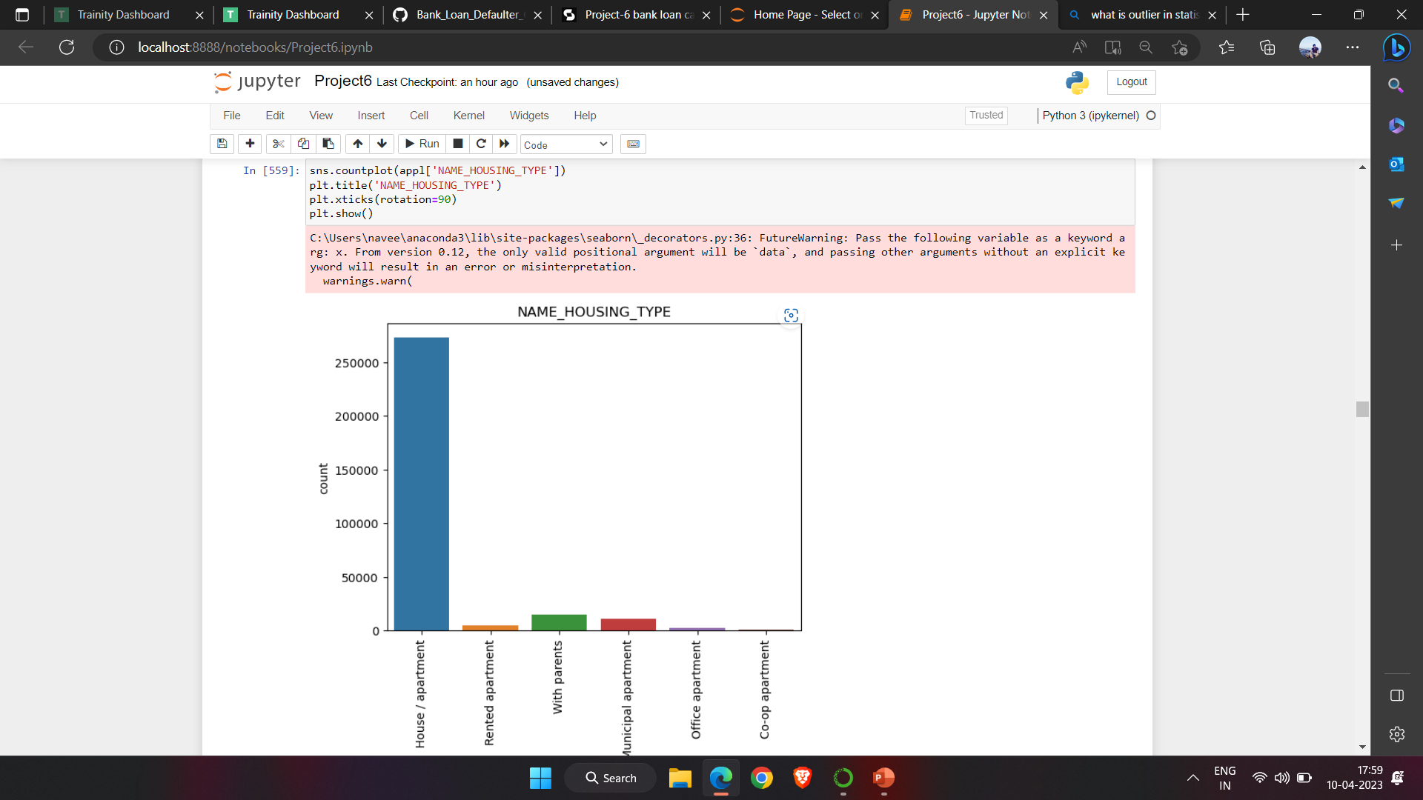

Slide 22
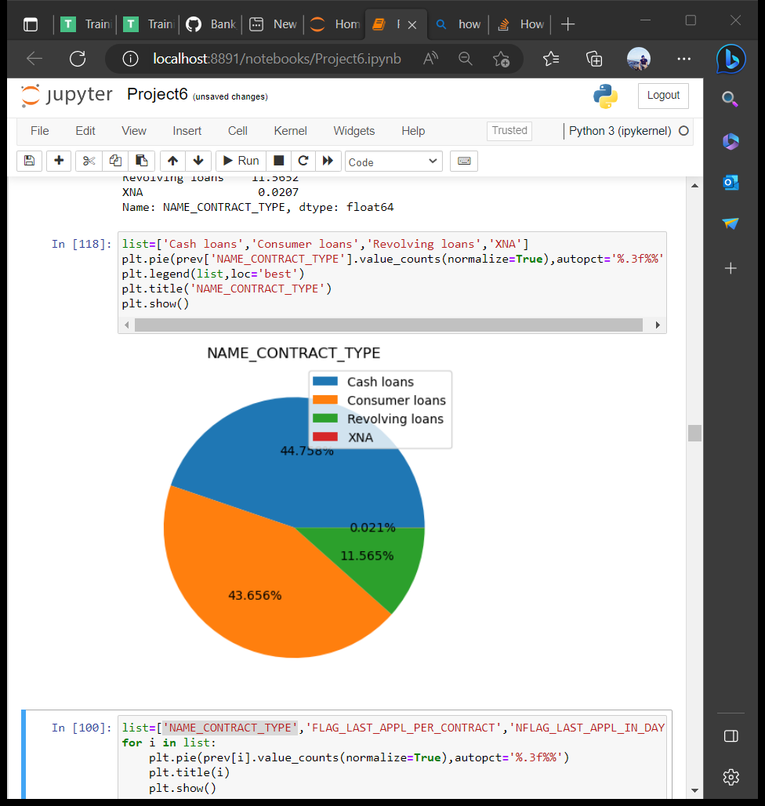
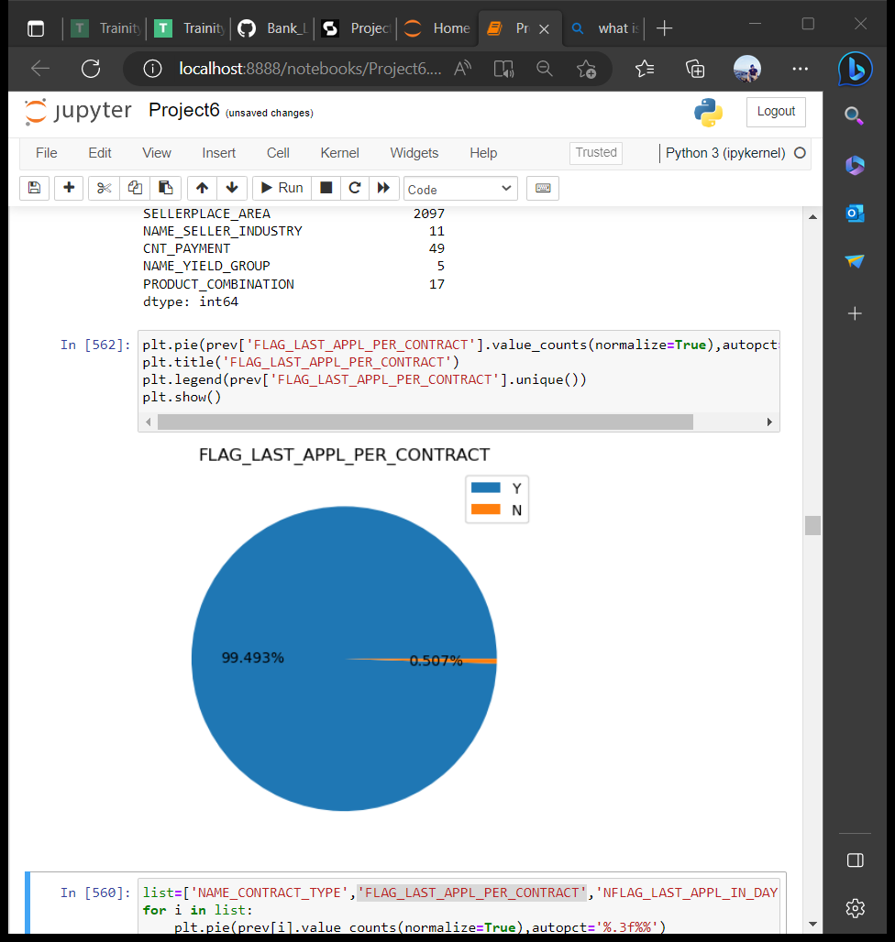
Previous_application.csv
I used pie chart to check the imbalance.

Slide 23
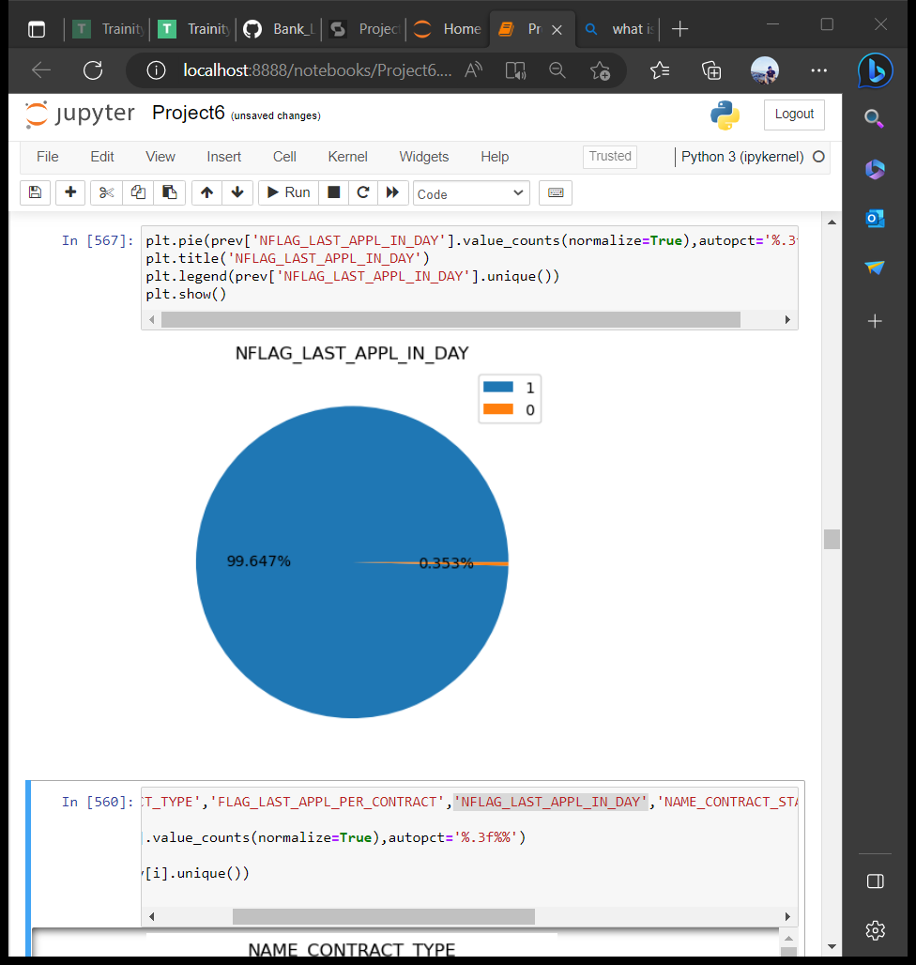
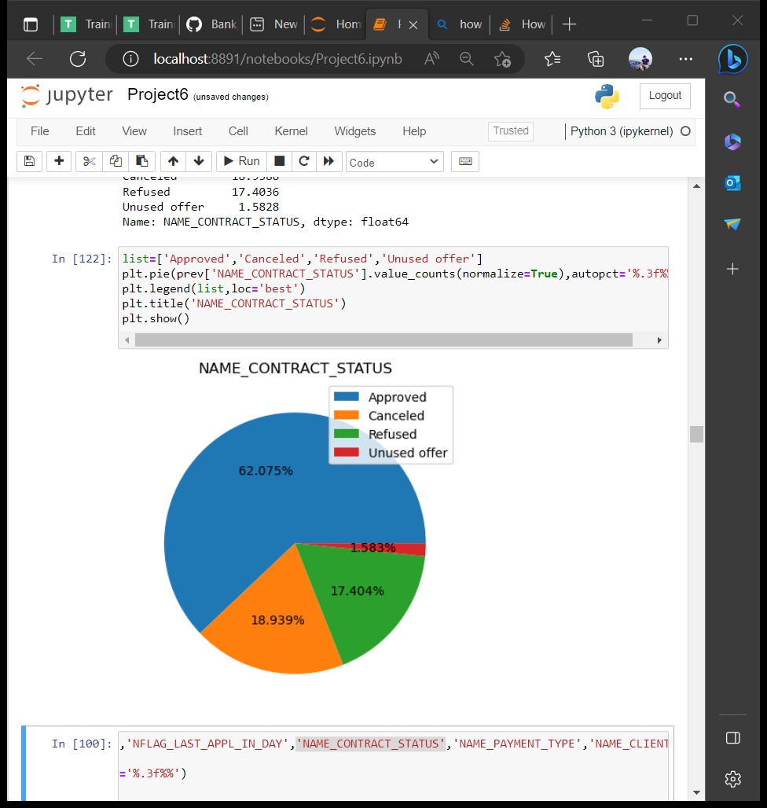

Slide 24
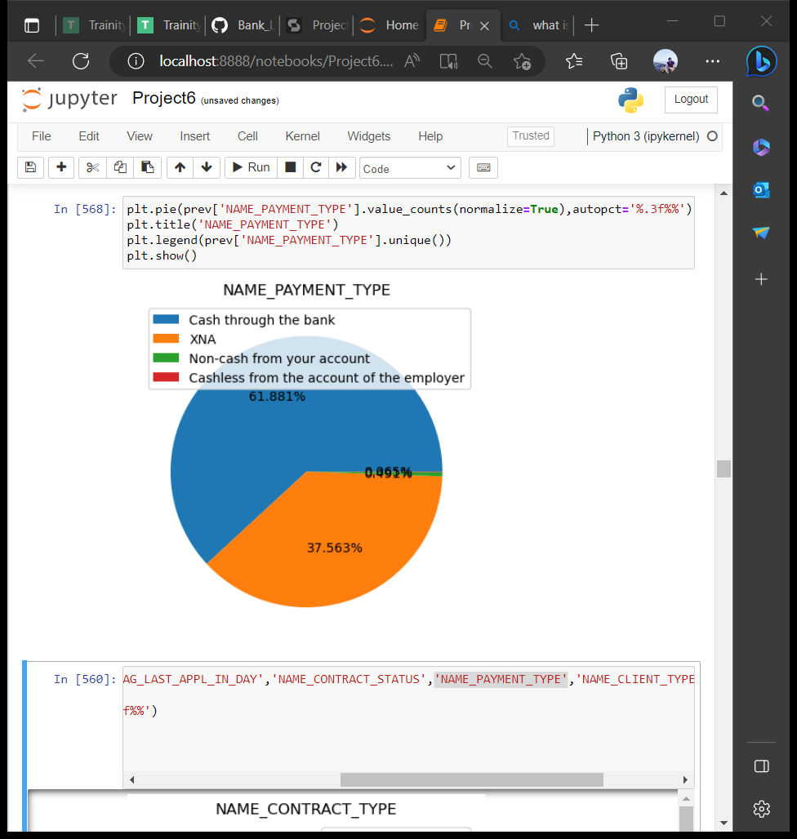
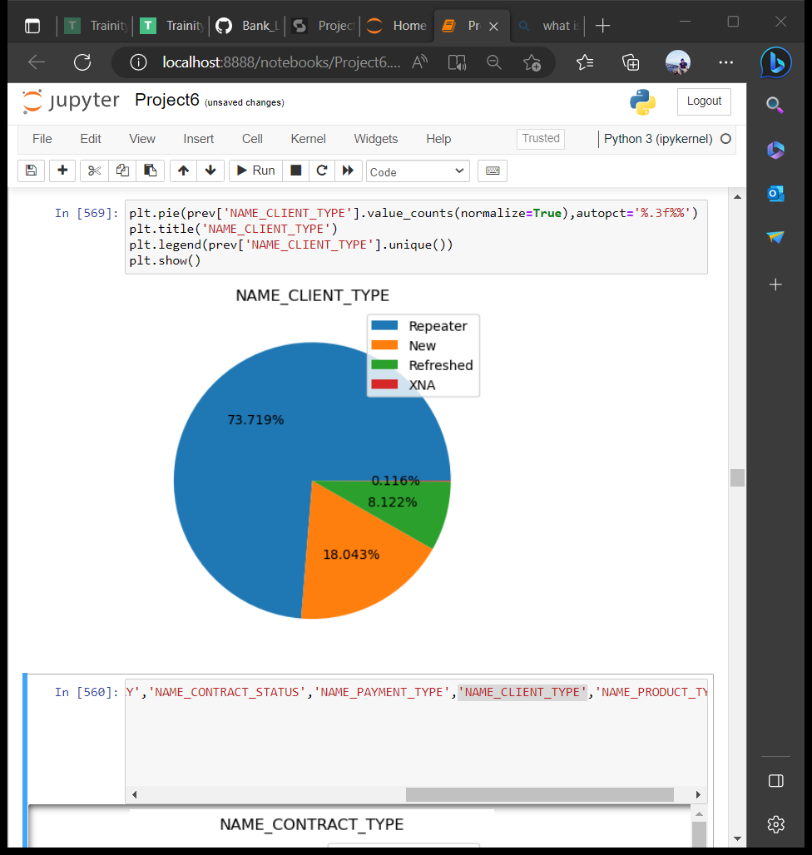

Slide 25
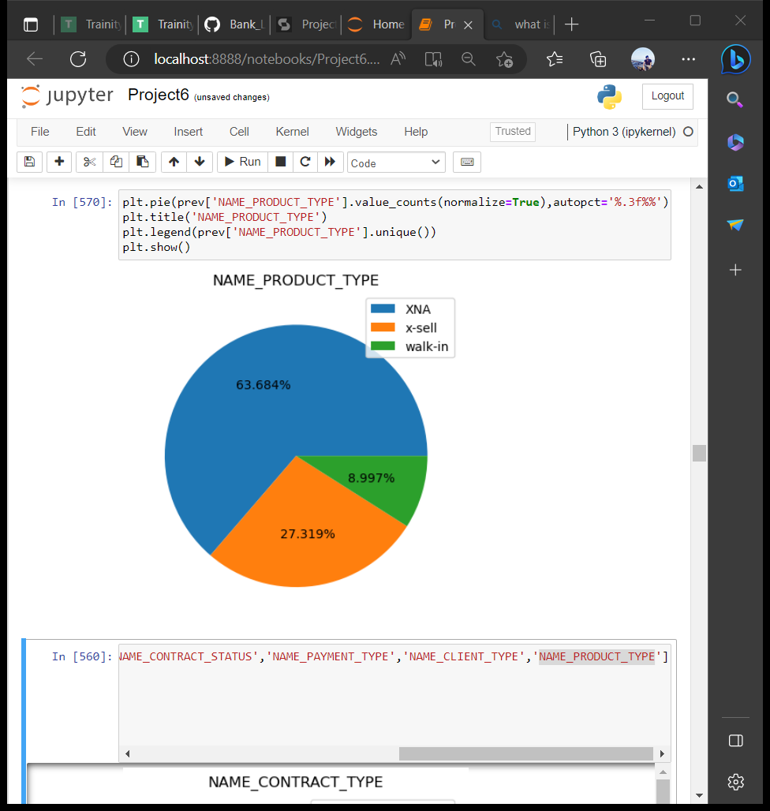

Slide 26
Univariate Analysis
Application_data.csv
To find the payment difficult clients,that mainly depend on client’s income,credit,age etc.
That is why I created three columns namely income_range,credit_range,age_range.
Income_range : range of income who applied for loan.
Credit_range : range of credit amount who applied.
Age_range : range of age.

Slide 27
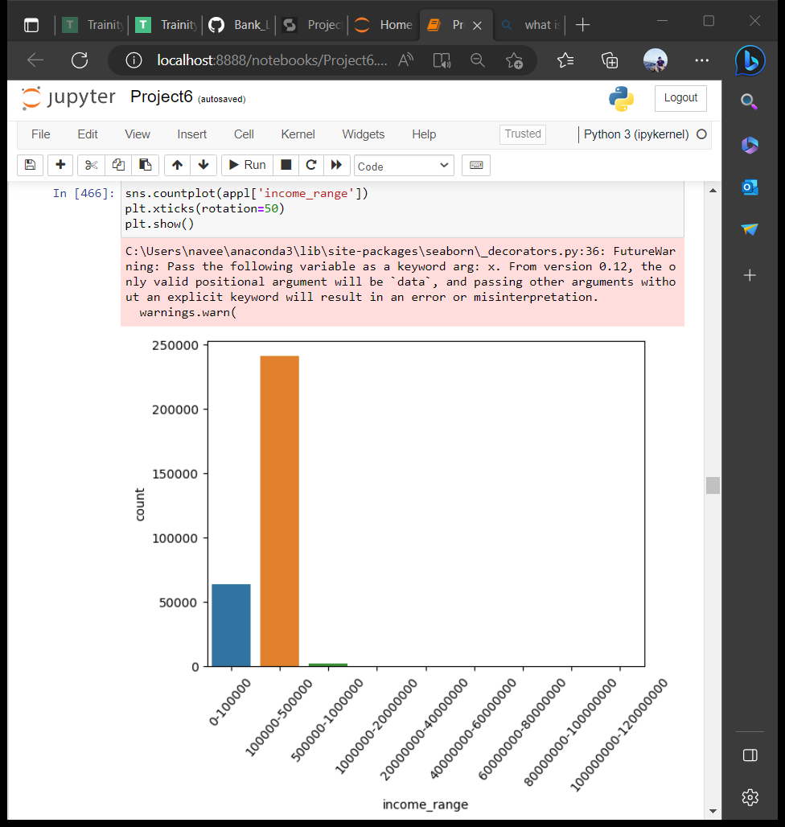
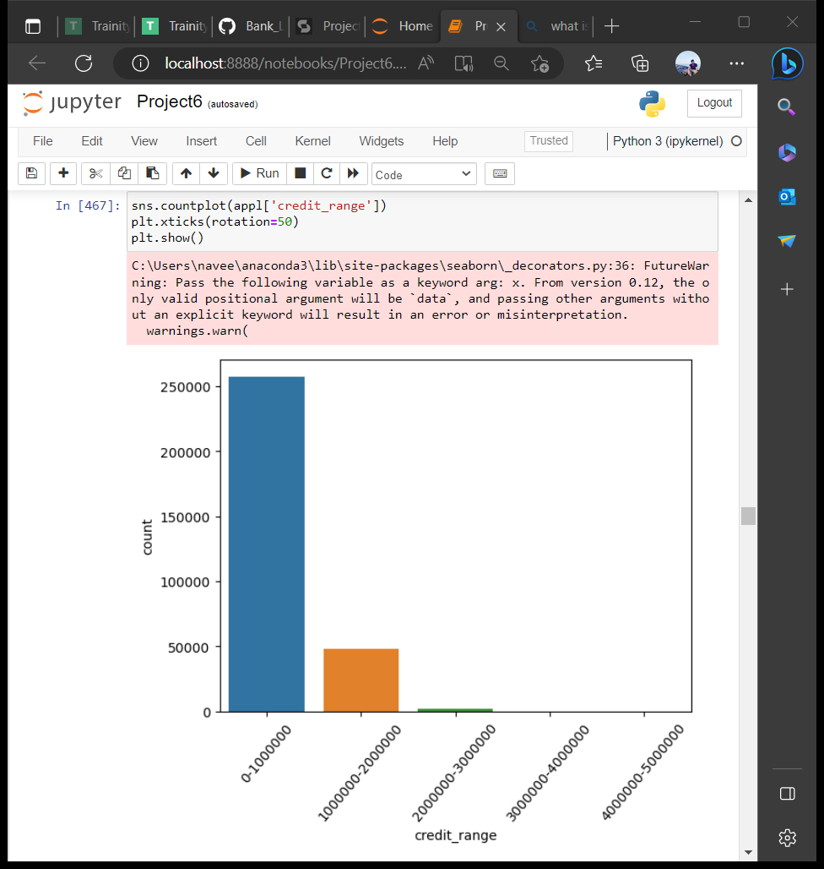

Slide 28

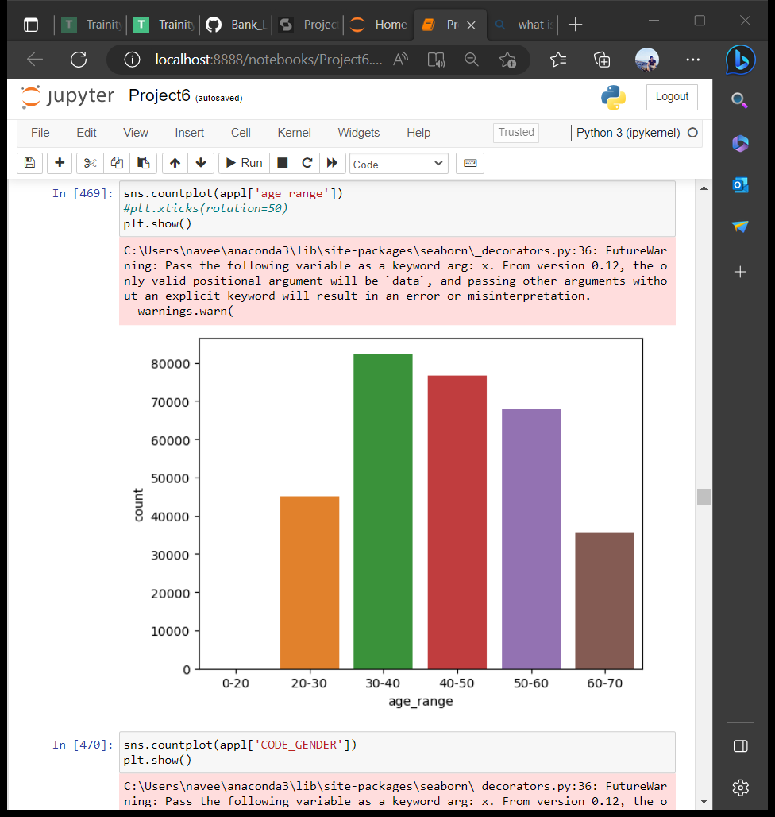

Slide 29
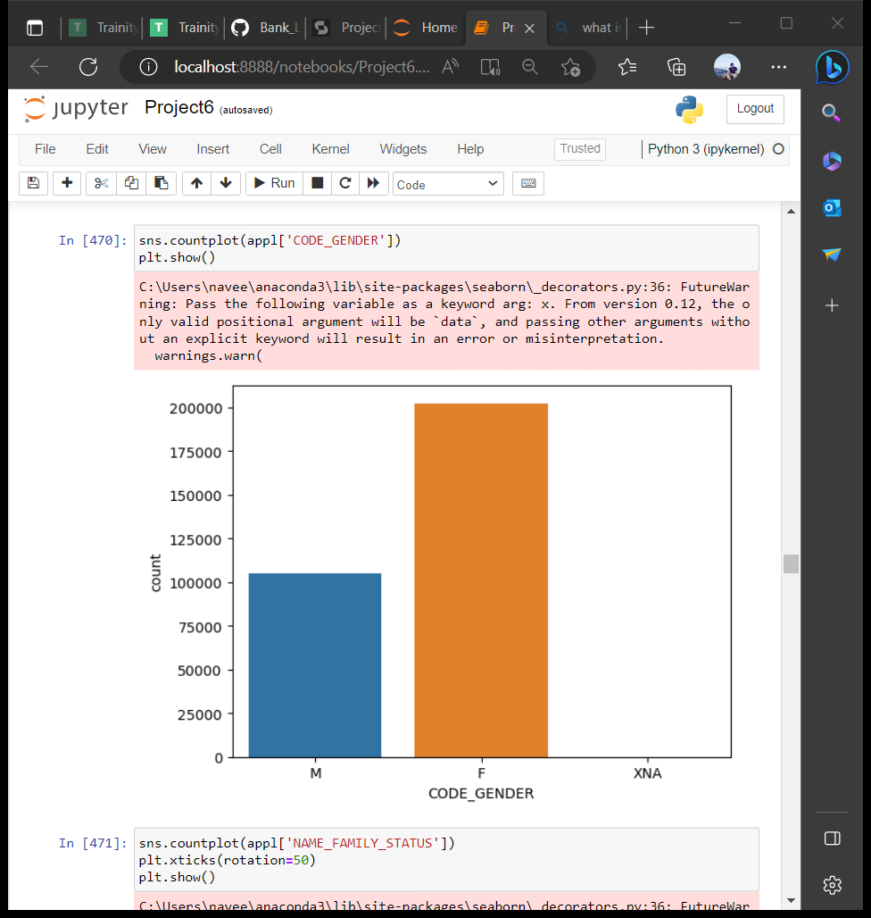
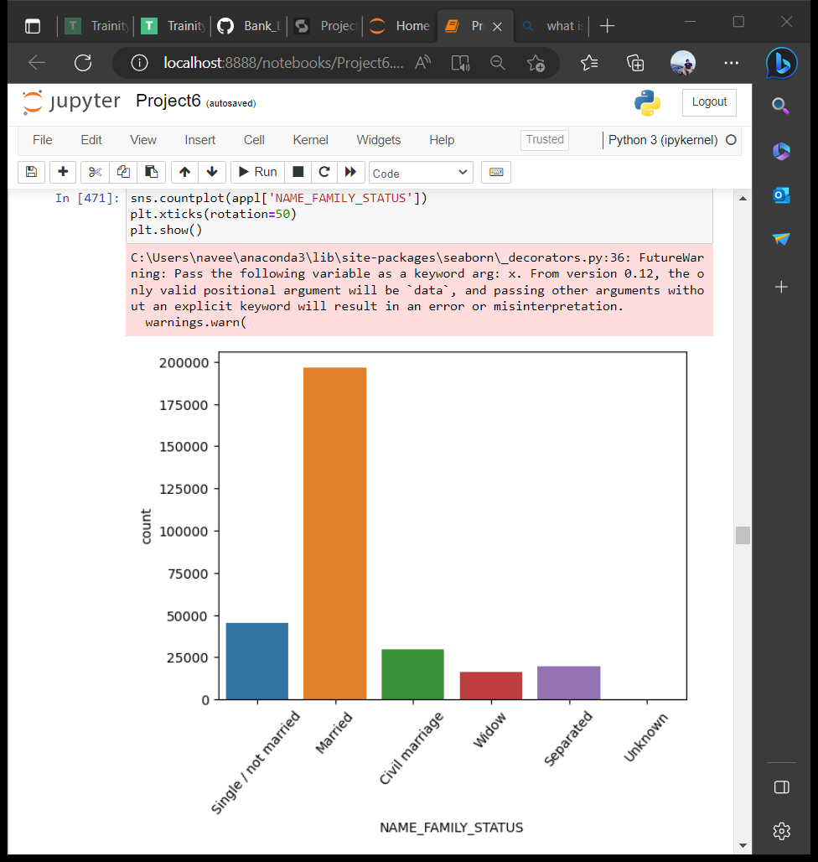

Slide 30
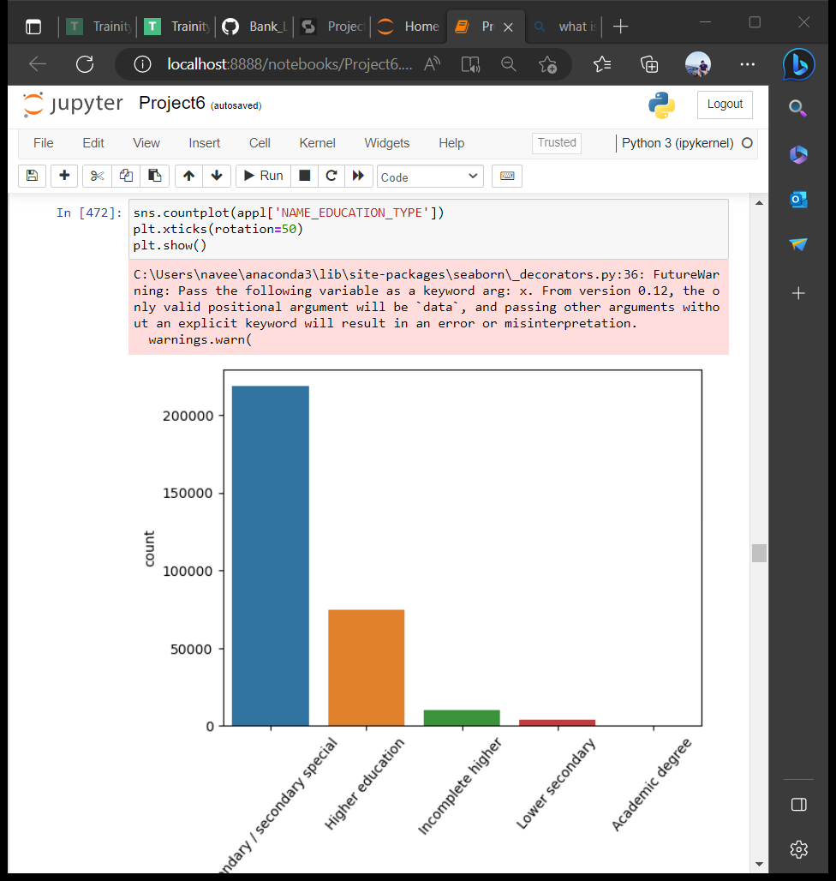
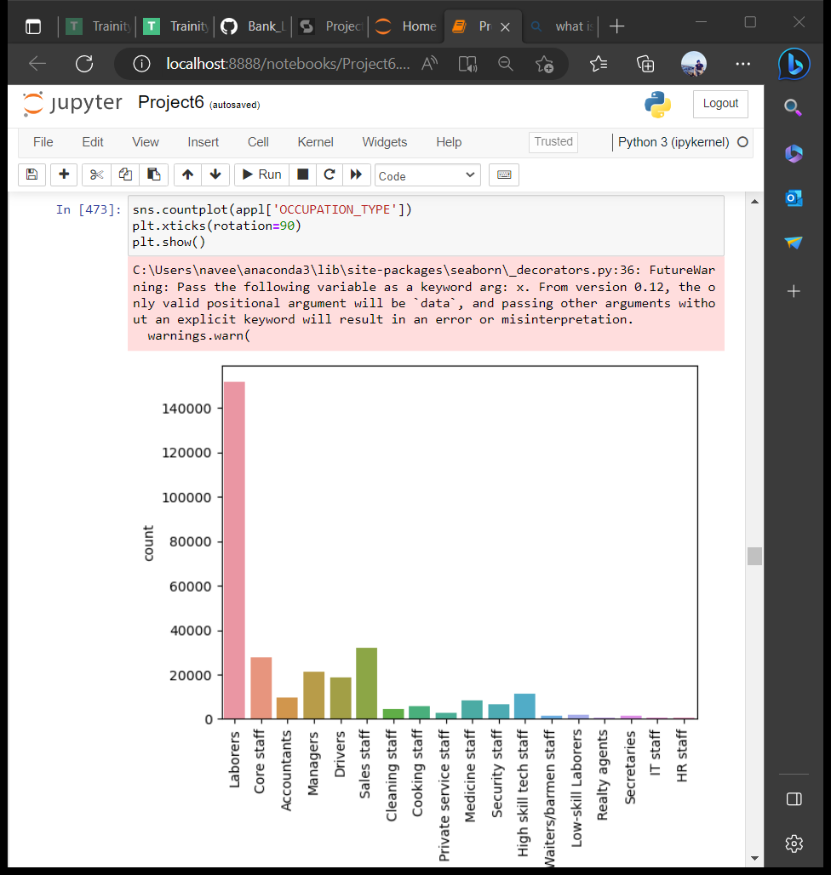

Slide 31
INFERENCE
The people who has high income and high credit are not applied for the loan.
The people who has age between 30 to 60 are the people with high number of applications for the loan.
Females are more than men in applying for loan.
Married are more interested in taking loans.

Slide 32
Labourers are high in number in applications for loans.
The people who has education qualification as secondary special are more in applying for loan.

Slide 33
Previous_application.csv
In this dataset I added two more columns namely annuity range and credit_range.
Annuity_range is range of annuity amount.
Credit_range is the range of credited amount.

Slide 34
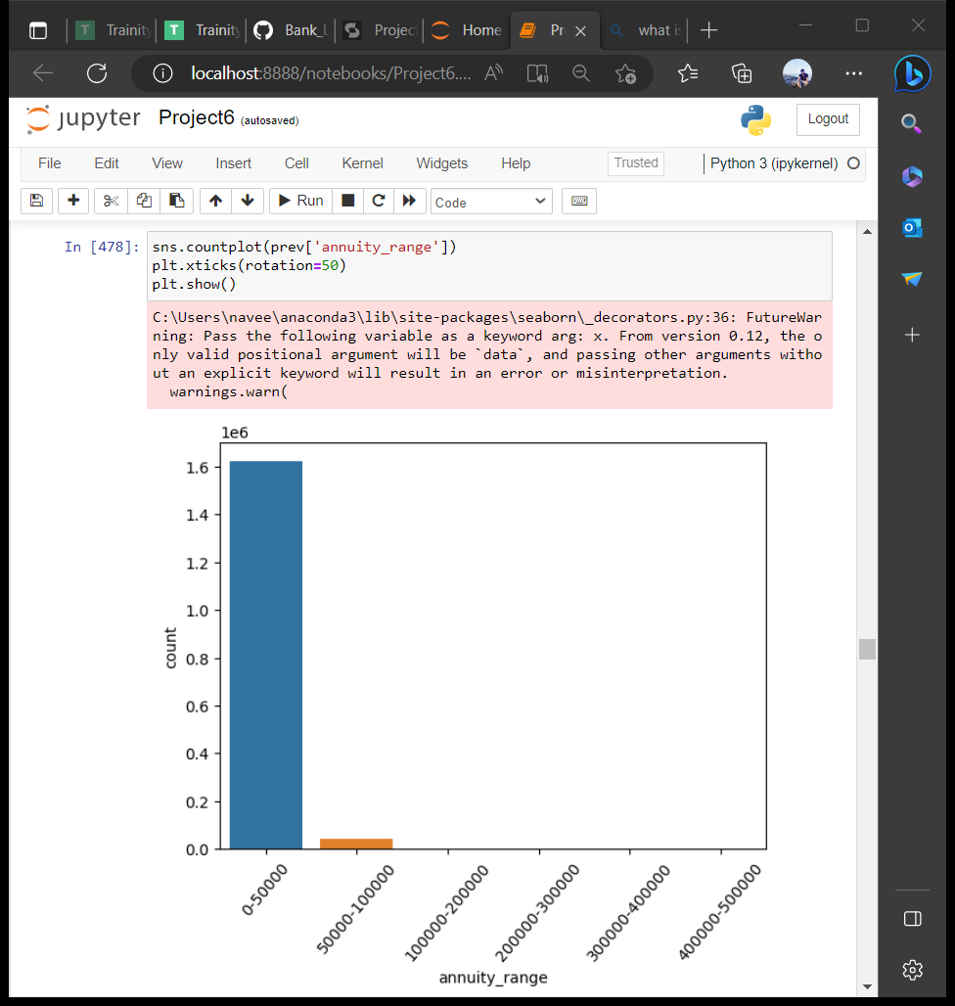
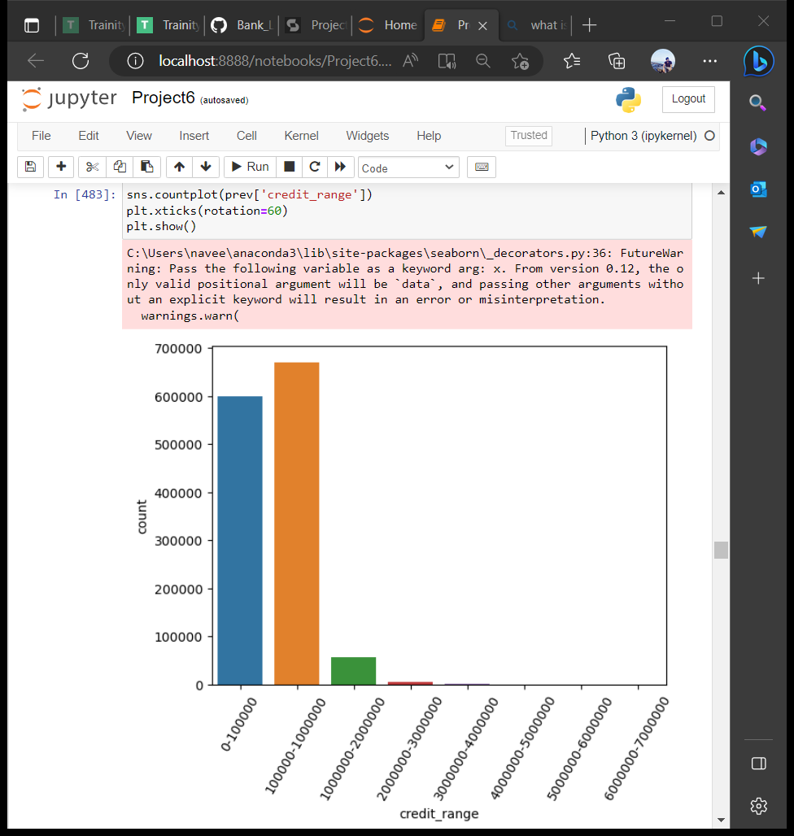

Slide 35
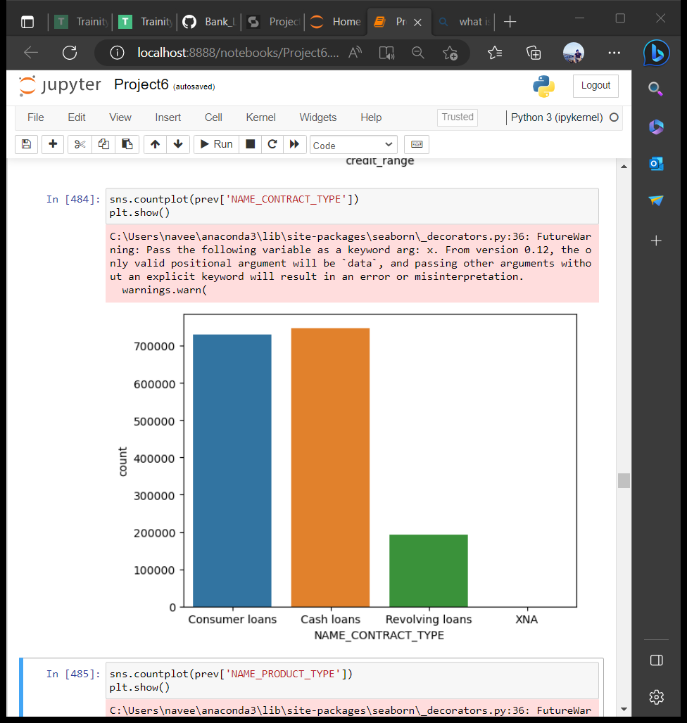
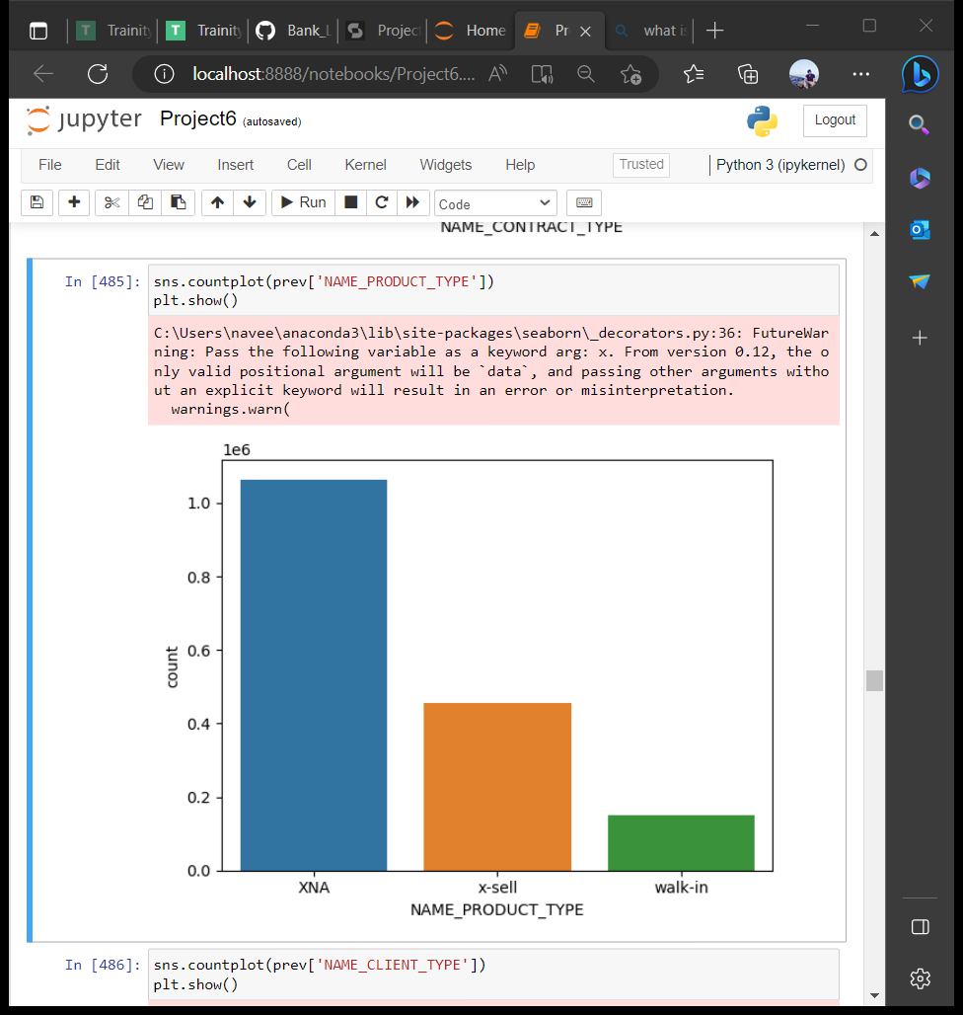

Slide 36
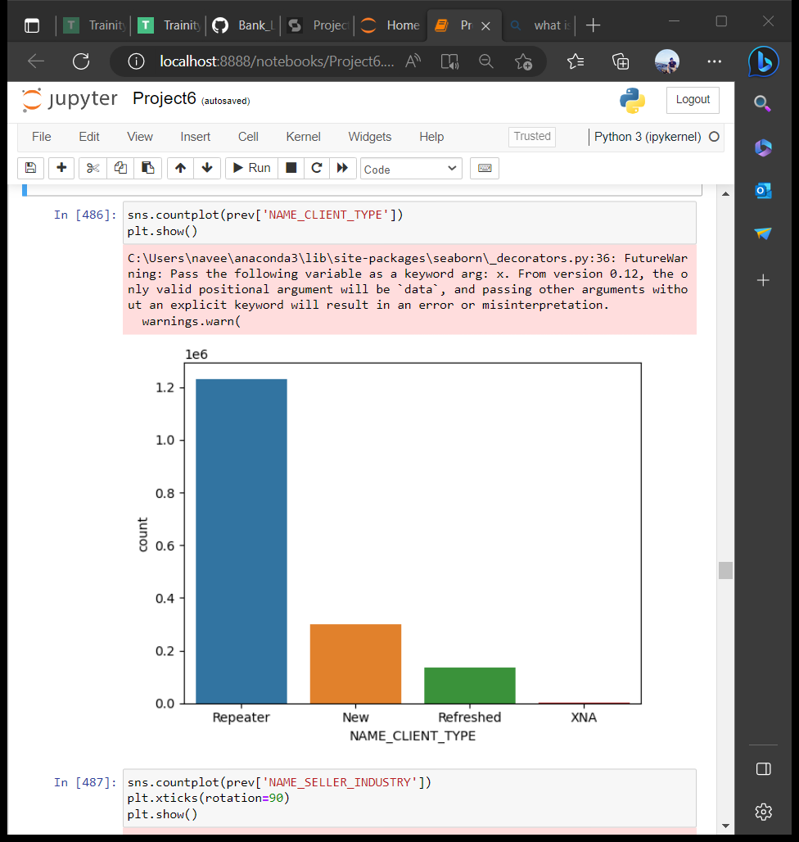
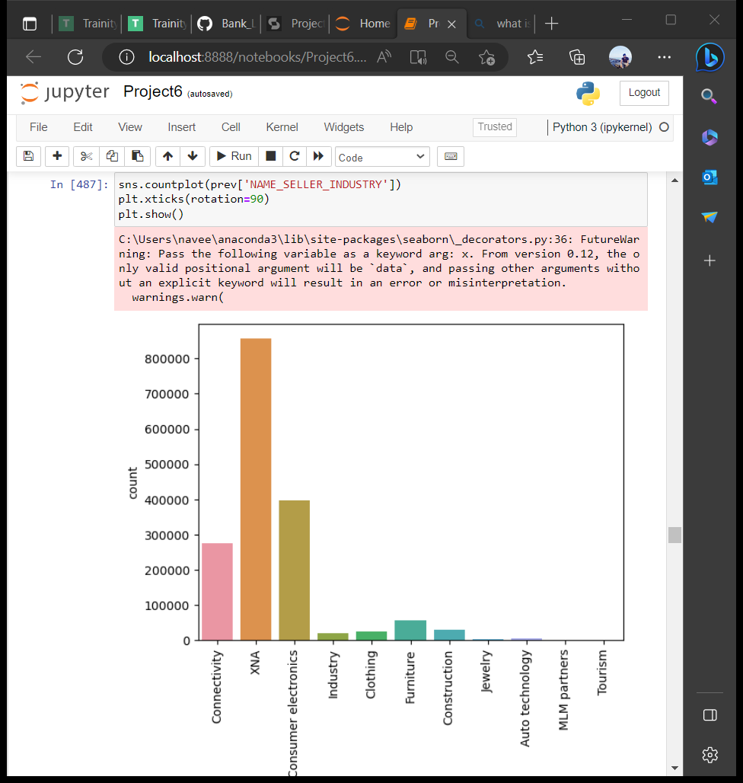

Slide 37
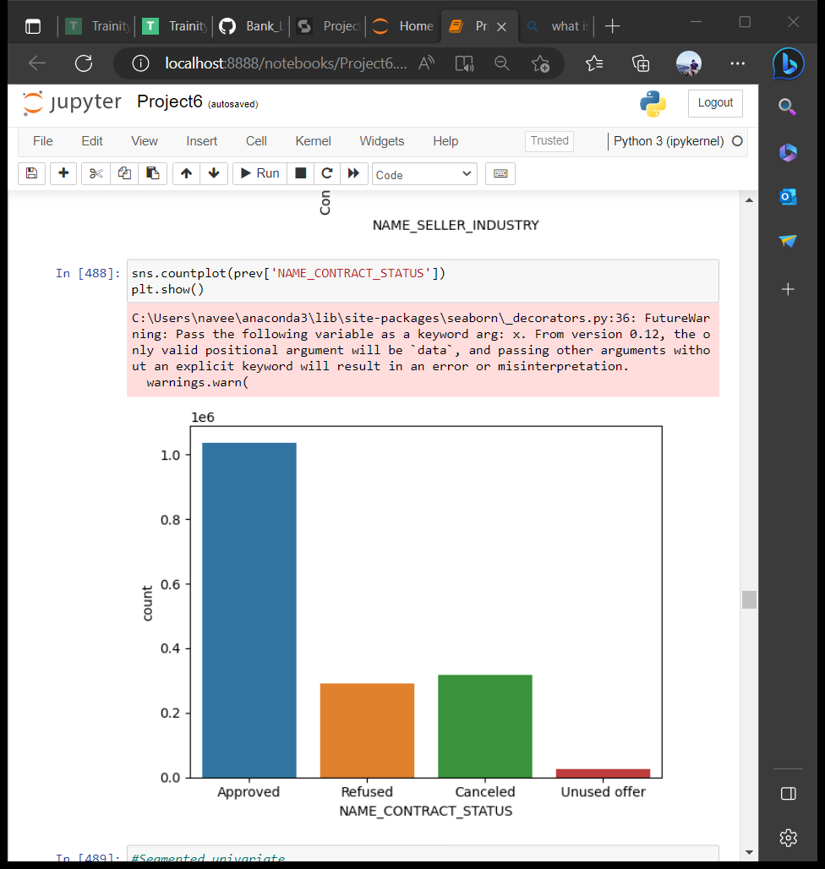

Slide 38
INFERENCE
In the past application,the annuity amount and credit amount is very less.
The majority type of loans are cash loans and consumer loans.
The most of the clients has the product type as x-sell.
The majority customers are repeated clients.

Slide 39
More loans have been requested for consumer electronics.
In the past applications,many of applications are approved for loan.

Slide 40
Segmented univariate
The target column in the dataset application_data.csv has 2 unique values which are 1 and 0.
I created 2 dataframes with namely target_0,target_1.
Target_0 has the dataset of application_data.csv who has target value as 0.
Target_1 has the dataset of application_data.csv who has target value as 1.

Slide 41
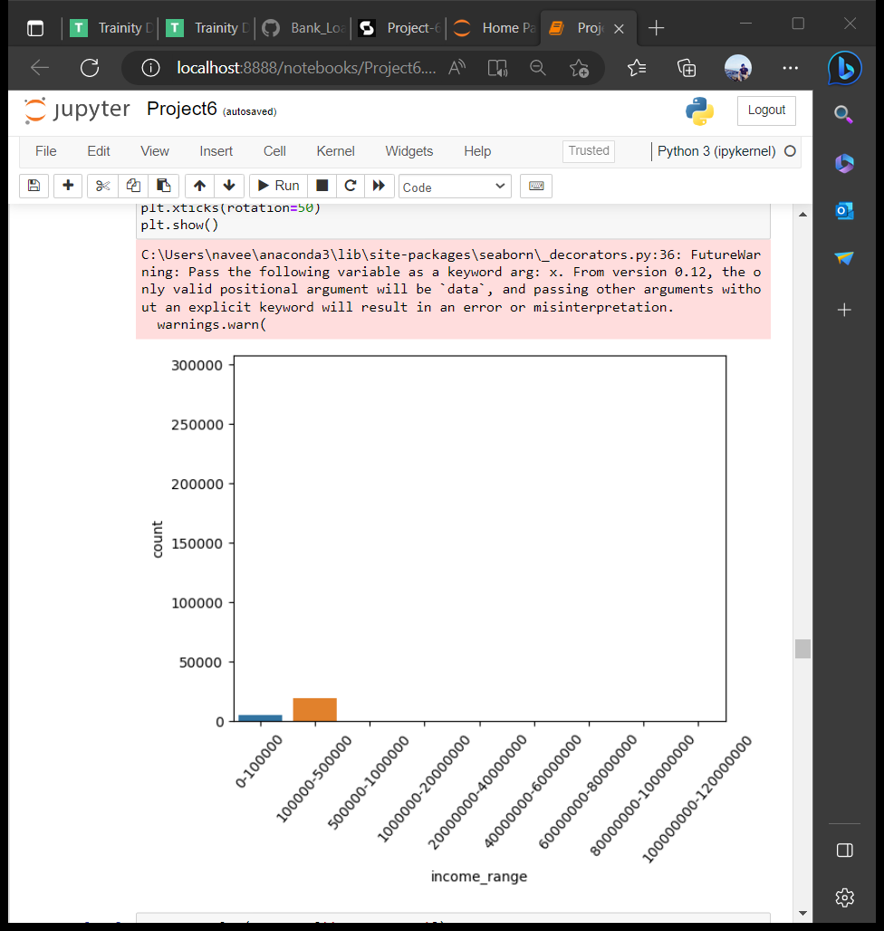
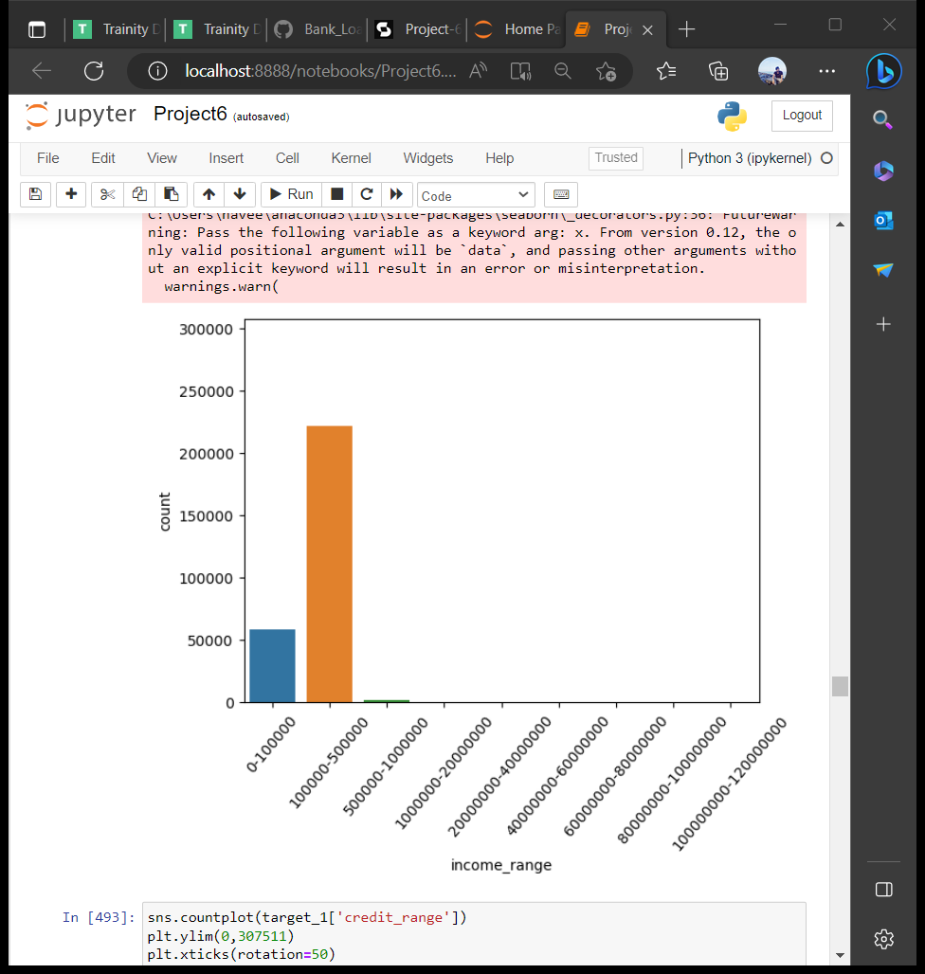
Target_1 Target_0
clients with Payment Difficulties All other cases

Slide 42
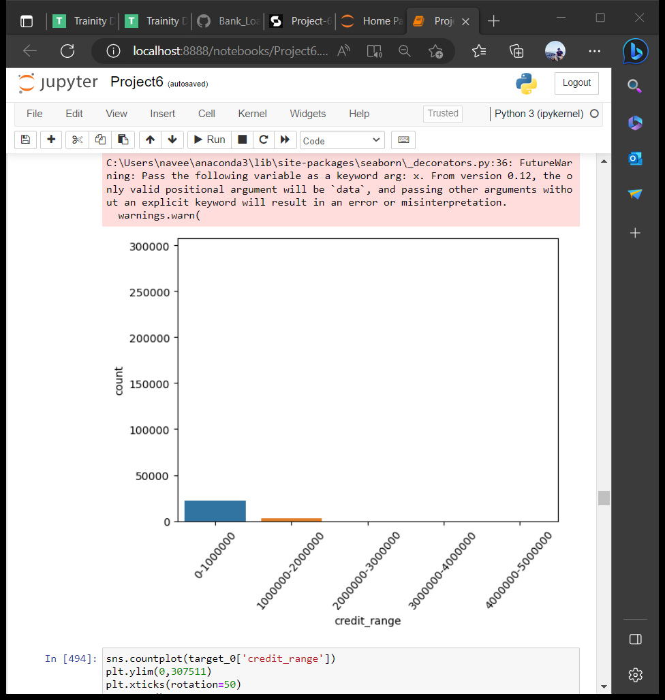
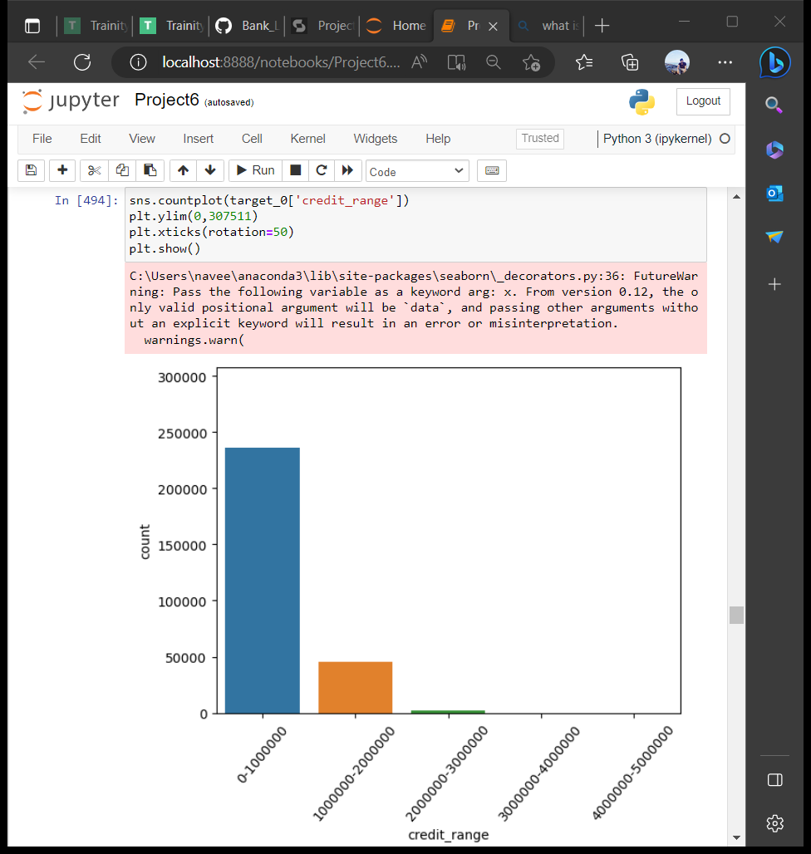
Target_1 Target_0
clients with Payment Difficulties All other cases

Slide 43
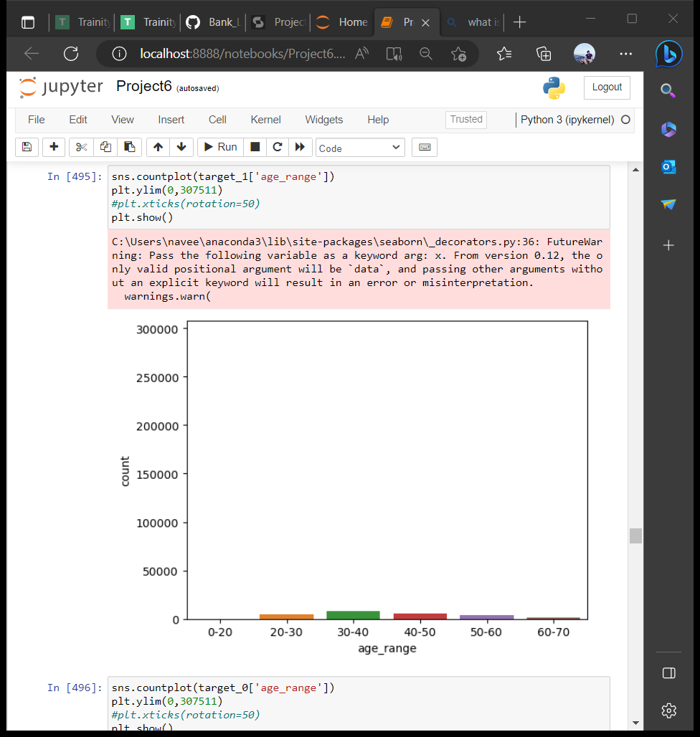
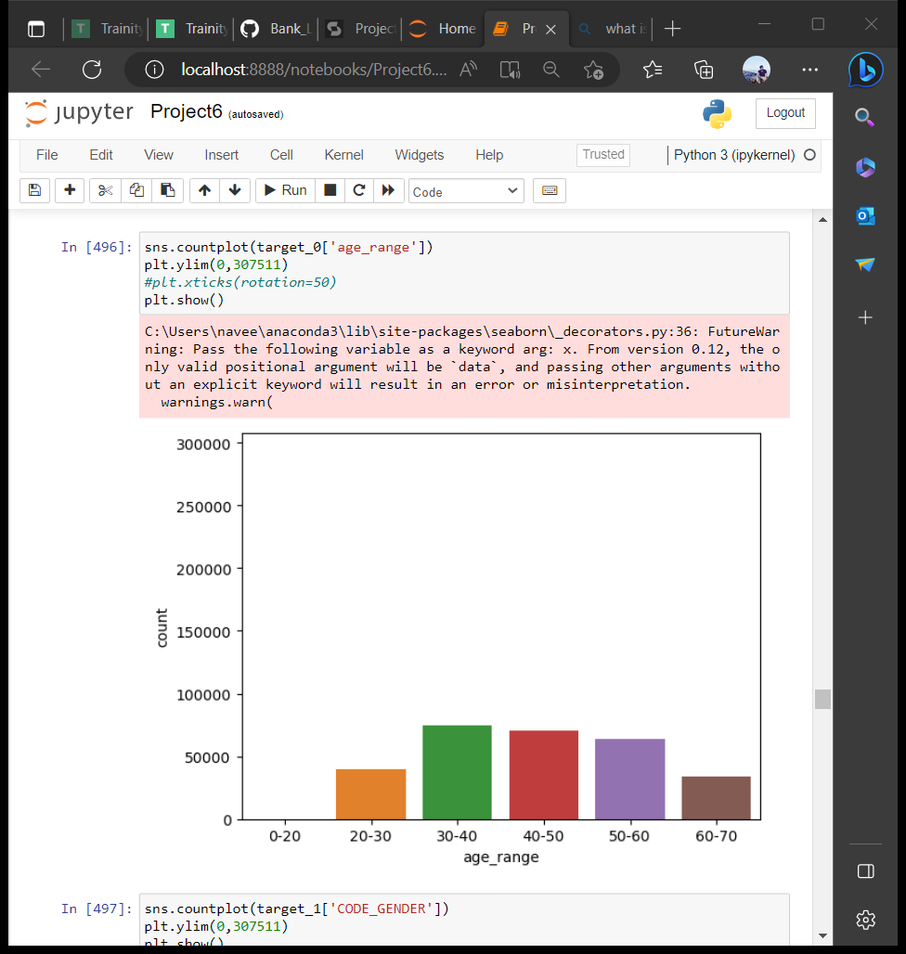
Target_1 Target_0
clients with Payment Difficulties All other cases

Slide 44
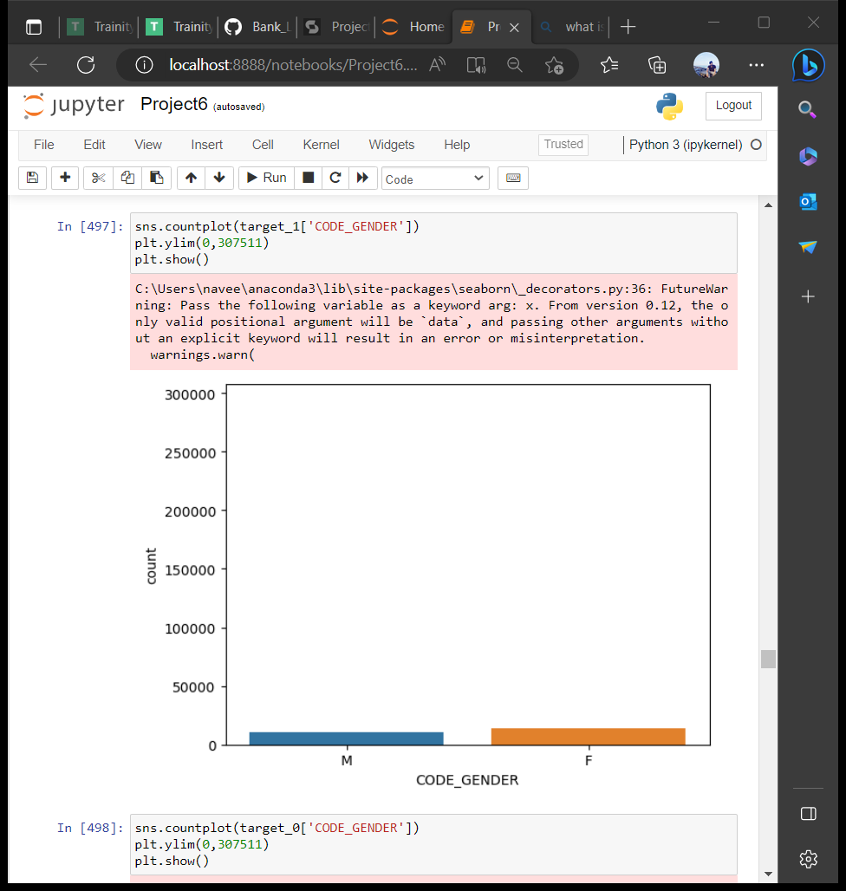
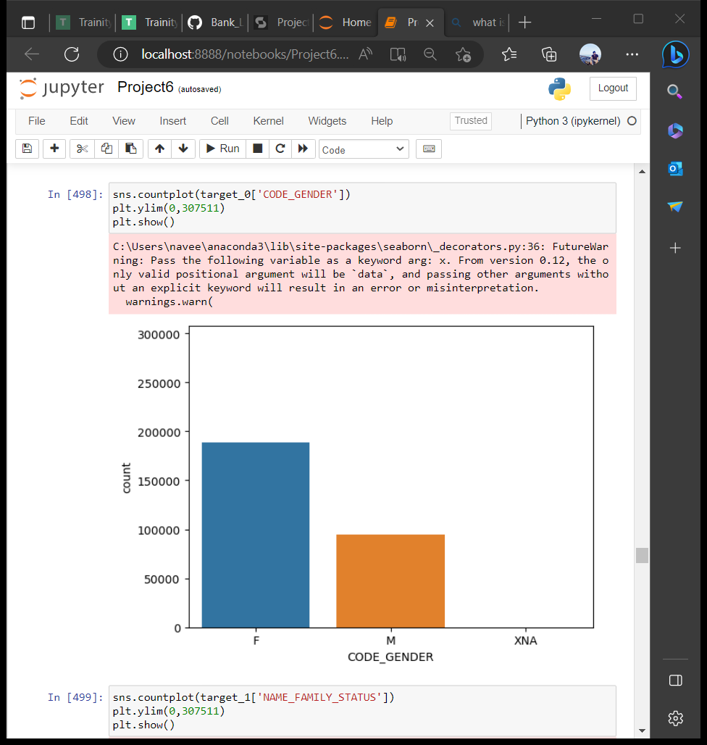
Target_1 Target_0
clients with Payment Difficulties All other cases

Slide 45
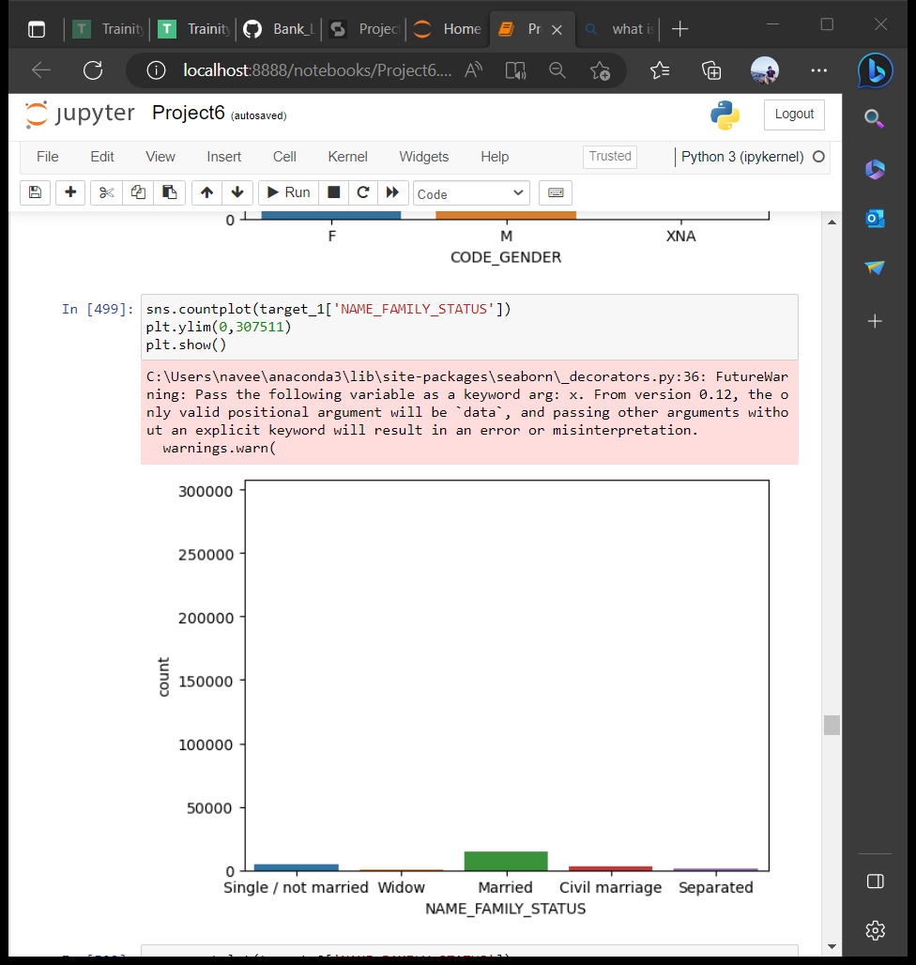

Target_1 Target_0
clients with Payment Difficulties All other cases

Slide 46
INFERENCE
The clients with low income and low credit are more in applying for loans and also has the difficulty in paying the loans.
The people with age between 60 to 70 has the less difficulty in paying loan.
Females are more in applying loans and most of them will pay back the loan amount.
There are more married people in applying for loans who are in target_0 dataset that means they doesn’t have difficulty in paying the loan amount.

Slide 47
Bivariate analysis
Application_data.csv
In the Bivariate analysis,we gonna use target column as one variable which is constantly taken to compare with other columns in the dataset.

Slide 48



Slide 49



Slide 50



Slide 51
INFERENCE
The most of the clients with low income,low credit and low annuity doesn’t have any difficulty in payment.
The most of the clients with age between 30 to 70 doesn’t have any difficulty in payment.
Females are more punctual in paying the loans compared to males.
Most of the married clients gonna pay the loan amount.

Slide 52
Previous_application.csv
In this dataset for bivariate analysis we gonna use contract_status (approved,refused, canceled,unused offer) column as constant variable to compare with other columns.

Slide 53



Slide 54



Slide 55



Slide 56


Slide 57
INFERENCE
The clients who applied for credit amount more than 3,000,000 are not approved.
The clients with annuity greater than 50,000 are not approved.
Most of the consumer loans are approved.
The repeated client has the high chances of not approved of loans compared to new and refreshed clients.
The approval rate is high for the loan who are requested for the consumer electronics.

Slide 58
correlation
The correlation between the columns are found using corr() and the top 10 is given below.
Application_data.csv
For the dataframe target_0 the highest correlated columns are OBS_60_CNT_SOCIAL_CIRCLE and OBS_30_CNT_SOCIAL_CIRCLE.
For the dataframe target_1 the highest correlated columns are OBS_60_CNT_SOCIAL_CIRCLE and OBS_30_CNT_SOCIAL_CIRCLE.

Slide 59


Target_0 Target_1

Slide 60
Previous_application.csv
I created 2 dataframes namely refused and approved.
Refused dataframe has the values of previous_application dataset which has the contract_status as refused.
Approved dataframe has the values of previous_application dataset which has the contract_status as approved.

Slide 61
For the dataframe Refused the highest correlated columns are AMT_GOODS_PRICE and AMT_APPLICATION.
For the dataframe Approved the highest correlated columns are AMT_GOODS_PRICE and AMT_APPLICATION.

Slide 62


Refused Approved

Slide 63

Merged dataset
I merged the 2 datasets on SK_ID_CURR column and did the analysis.
Most approved clients in past doesn’t have difficulty in payment.

Slide 64

Most of the laborers clients has the approvement of the loans in the past.

Slide 65

Most of the working clients got the approvement for the loans in past.

Slide 66

Most of the laborers have no difficulty in paying the loan

Slide 67

Most of the working employees have no difficulty in paying the loan.

Slide 68

Most of the clients who got loans on the purpose of XAP doen’t have difficulty in payment.

Slide 69
Summary
While giving loans,Banks should consider the clients with unused_offer,approved in contract_status as they will payback the loans.
Clients with other and repair as their purpose for the loan in the past as they most likely pay the loan.
Clients who are married,widow,separated and civil marriage as they gonna pay the loans.
Clients who are senior citizens are most likely to payback the loan.

Slide 70
Clients who are more educated gonna payback the loan.
Giving loans to the clients who has low income , unemployed and low educated will result to high-risk.

Slide 71
Result
I went through the risk analytics process step by step, task after task. By doing this I understand how risk analysis is used in determining the decisions in business sector.

Slide 72
THANK YOU!!!

